Slide 1
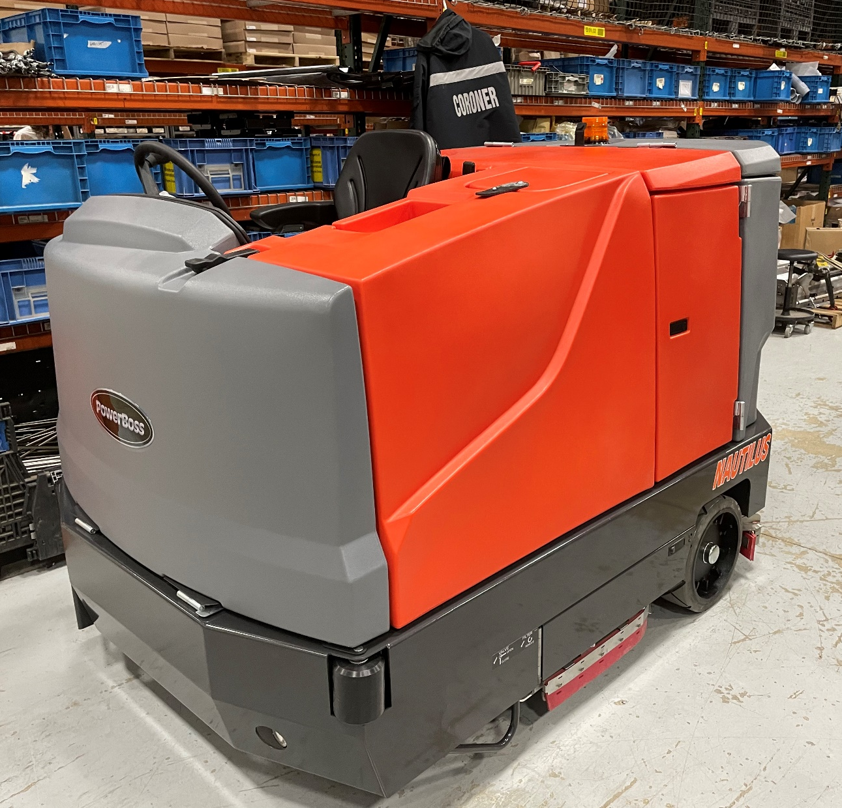
Assembly Instructions Station 1
Nautilus E
Pages 1-118

Slide 2
Frame and Inserts Material List & Locations
Component | Object Description | Usage Qty | Storage Bin
600852 | INSERT-M8-1.25 .188 GRIP ZP | 10 | MIN02D07
All MIN & FAS items on Hardware cart

Slide 3
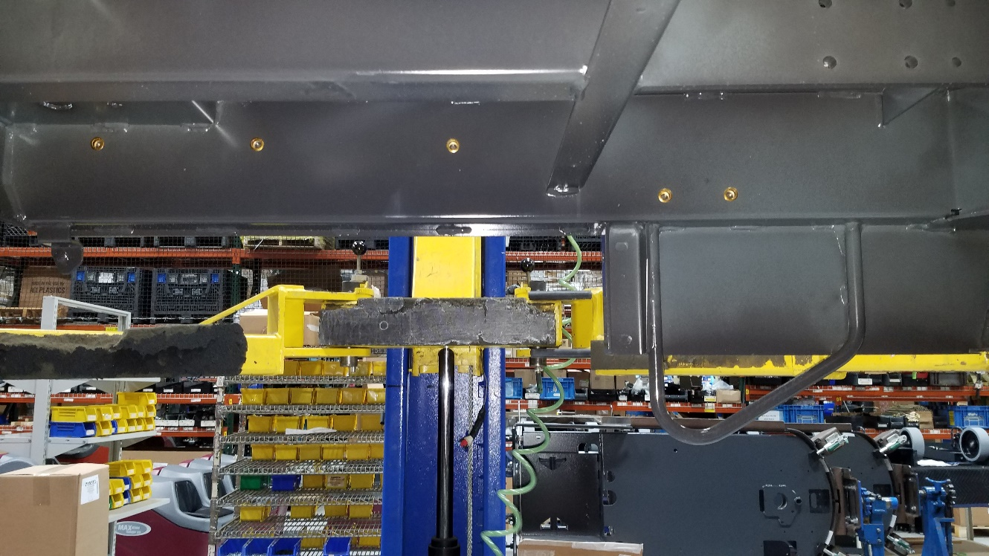
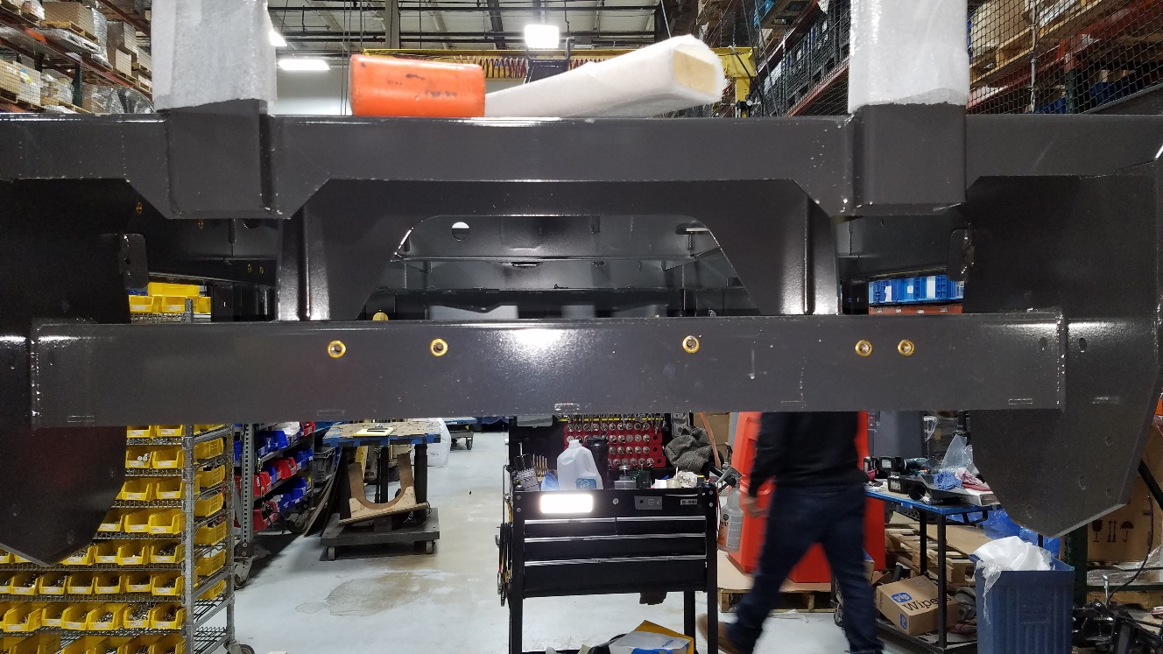
Frame Inserts Pg 1 of 1
Left
(10)600852
Install 5 (600852) inserts to the inside of the frame (LEFT SIDE)
Install 5 (600852) inserts to the rear of the frame
Rear

Slide 4
Impeller Exhaust Outlet Material List & Locations
Component | Object Description | Usage Qty | Storage Bin
718390 | WELDMENT, EXHAUST MANIFOLD | 1 | A1813G02
731006 | SCR-HH M6-1.00 X 25 ZP CLASS 8.8 | 6 | FAS10B06
717018 | NUT-NYLOC M6 X 1.0 ZP | 2 | FAS03G06
718439 | DIVERTER, IMPELLER EXHAUST | 1 | A1813G01
730535 | INSERT-M6-1.00, .7 - 4.2 GRIP | 4 | MIN02E01

Slide 5
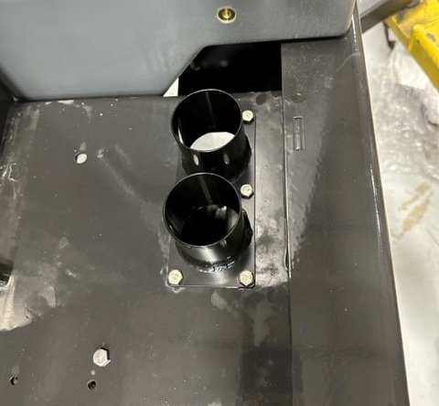
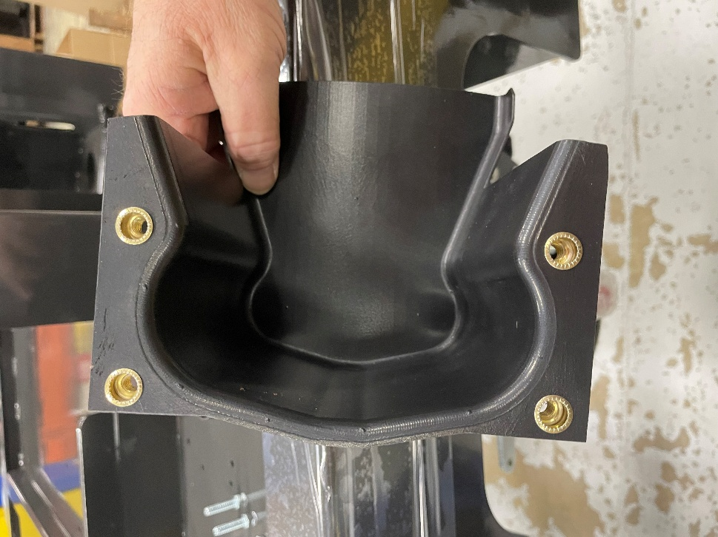
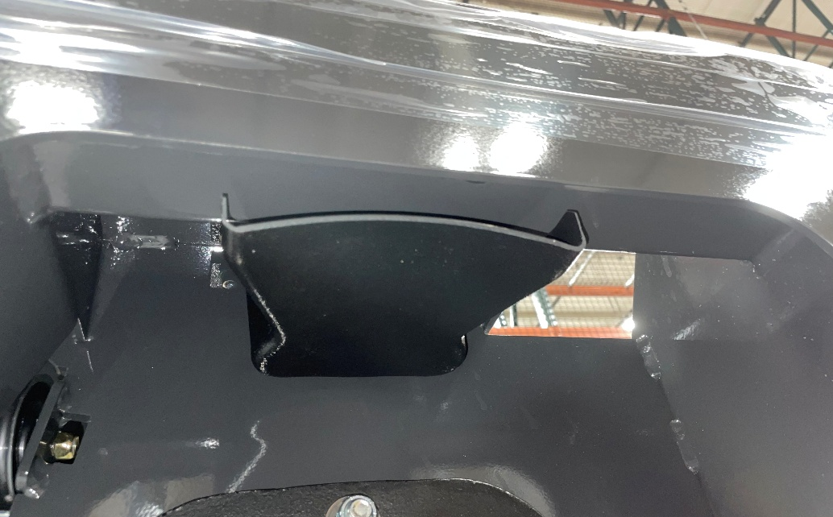
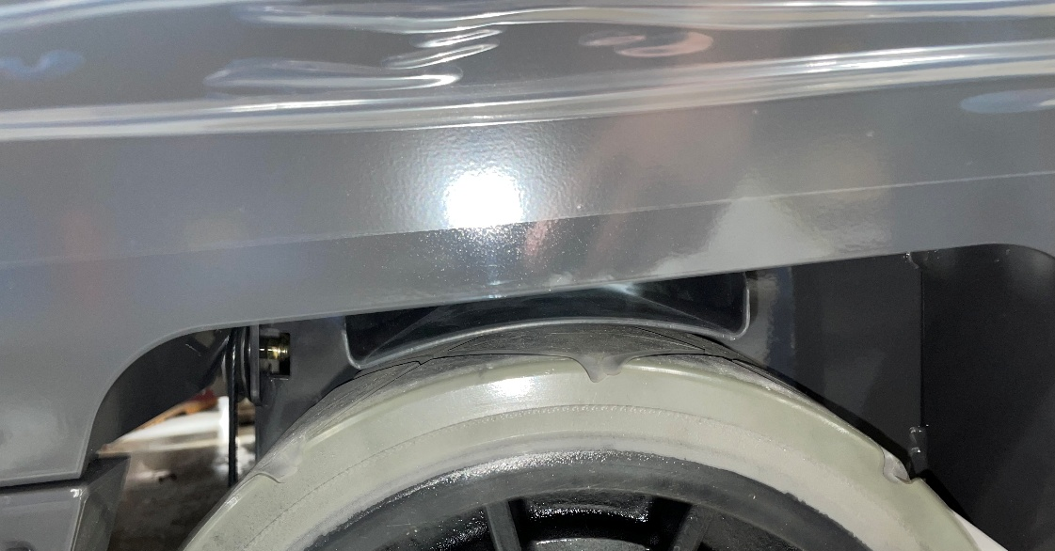
Impeller Exhaust Outlet Pg 1 of 1
(4)730535
718390
718439
(6)731006
(2)717018
718439-1
Install 4 inserts (730535) into weldment (718349)
Install weldments (718390) & (718349-1) onto frame with 6 screws (731006) and 2 nyloc nuts (717018)

Slide 6
Brake Pulley Material List & Locations
Component | Object Description | Usage Qty | Storage Bin
600114 | SPACER, .328 B .498 OD .500 ,SS | 6 | A1804H02
600113 | PULLEY, .50 B 2.00 D .44T | 6 | A1908D01
600115 | RETAINER, CABLE, ZP | 6 | A1804I02
11038254 | SCR-HH M8-1.25 X 30 ZP CLASS 8.8 | 6 | FAS07F03
12040051 | NUT-NYLOC M8 X 1.25 ZP CLASS 8 | 6 | FAS07F08

Slide 7
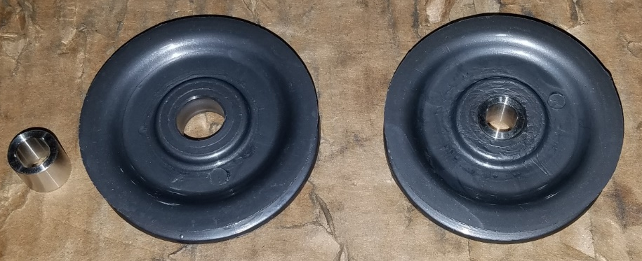
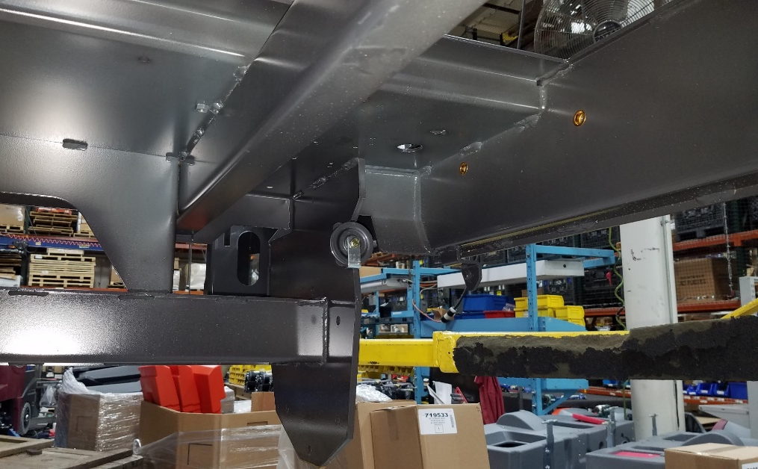
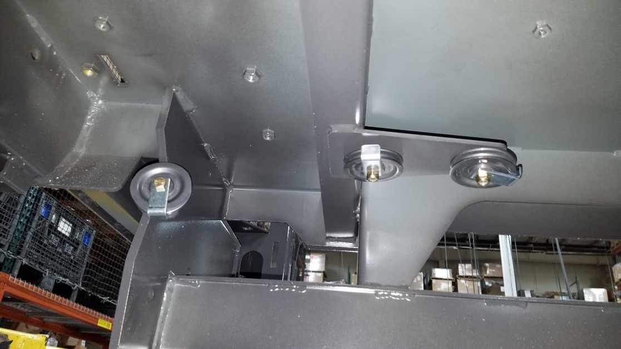
Brake Cable Pulley Pg 1 of 2
Insert spacers (600114) into pulley (600113) (6 total)
Install pulley (600113) onto frame with cable retainer (600115) by using screw (11038254) and nyloc nut (12040051) as shown in the pictures below
Other pulley locations are continued on next page
(6)600114
(6)600113
(6)600115
(6)11038254
(6)12040051

Slide 8
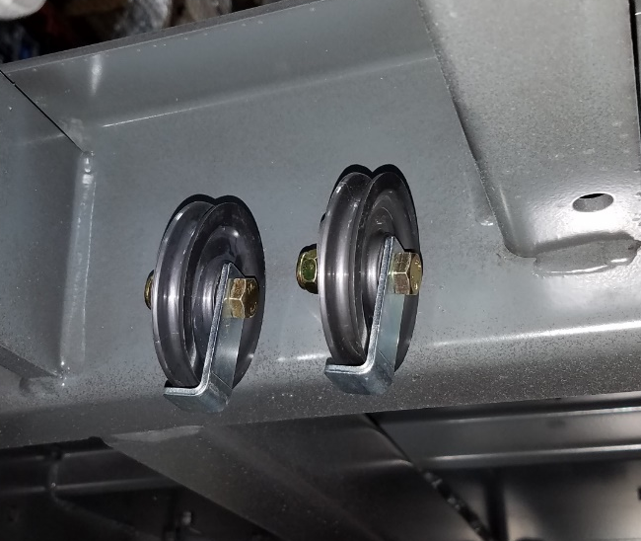
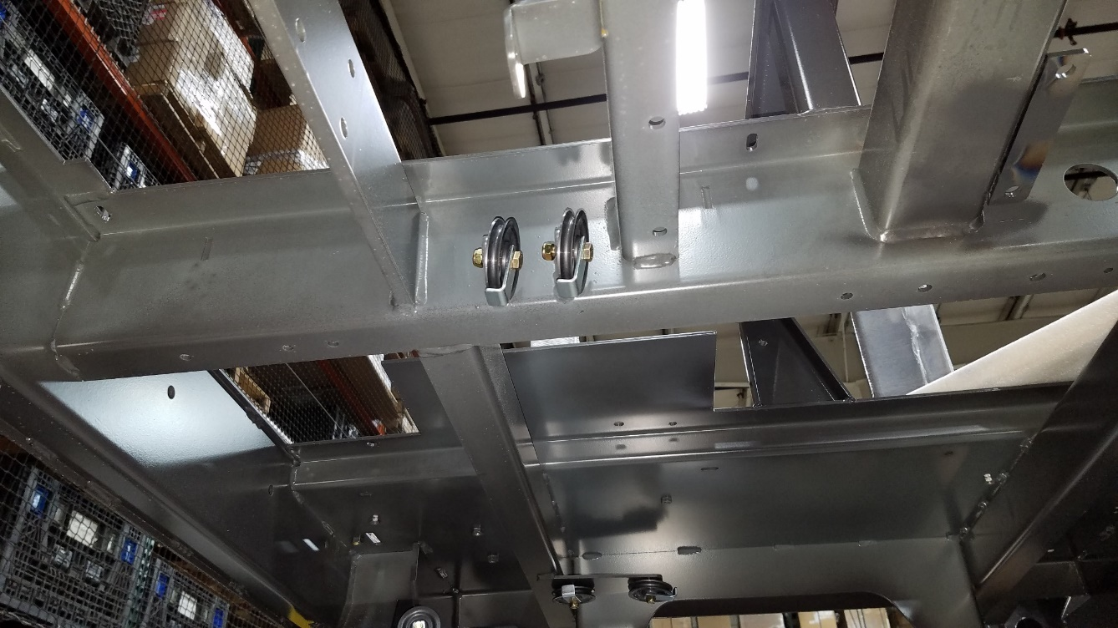
Brake Cable Pulley Pg 2 of 2
Repeat steps from previous page

Slide 9
Brakes/Cable Material List & Locations
Component | Object Description | Usage Qty | Storage Bin
730316 | ASSEMBLY, BRAKE-AXLE | 2 | A1535E01
712047 | SCR-HH 1/2-13 X 1.50 ZP GR 5 | 6 | FAS07G08
711376 | NUT-NYLOC 1/2-13 ZP | 6 | FAS08B01
3400125 | RING-RUE 3/8 | 3 | MIN02J05
450034 | PIN-CLEVIS 5/16 X .75 ZP | 2 | A1804H02
718163 | CABLE, BRAKE, RH | 1 | A14LINE
718164 | CABLE, BRAKE, LH | 1 | A1814B01
600338 | TURNBUCKLE 0.375 | 1 | A1804I02
3400075 | NUT-JAM 3/8-24 ZP | 2 | FAS01I08
600938 | NUT-JAM 3/8-24 ZP GR 5 LEFT HAND THREAD | 1 | FAS01B07
3400118 | PIN-CLEVIS 5/16 X .875 ZP | 1 | FAS01G10
600121 | WELDMENT, CLEVIS, BRAKE PULLEY | 1 | A1804I02
600113 | PULLEY, .50 B 2.00 D .44T | 1 | A1908D01
600125 | CATCH, PARKING BRAKE | 1 | A1802D02
600813 | CLEVIS 3/8-24 | 1 | A1814B01
600114 | SPACER, .328 B .498 OD .500 ,SS | 1 | A1804H02

Slide 10
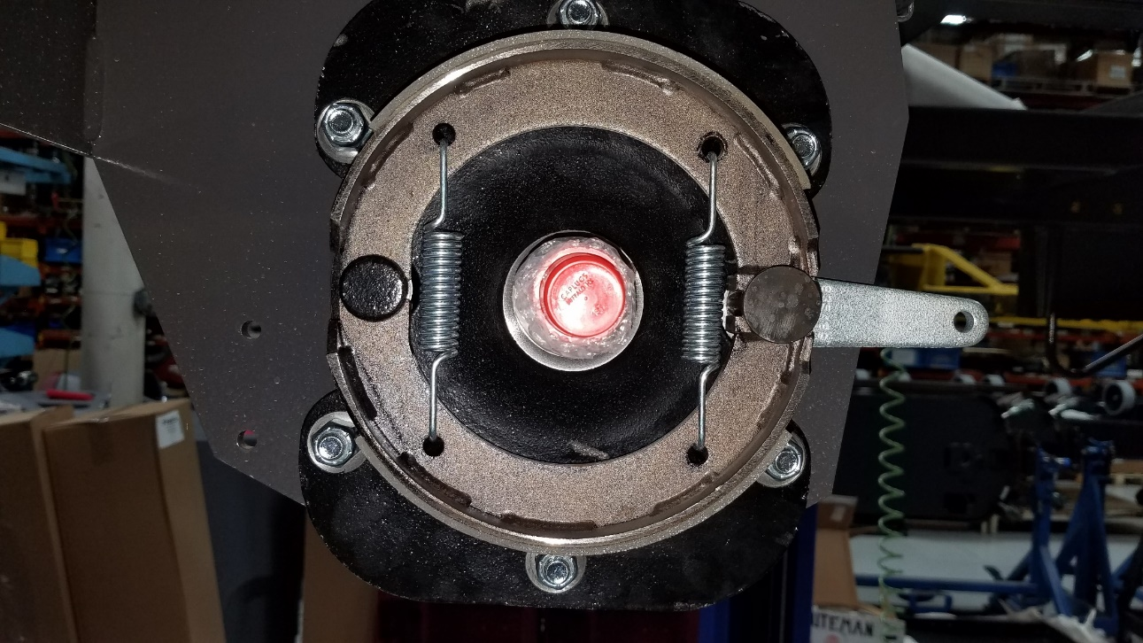
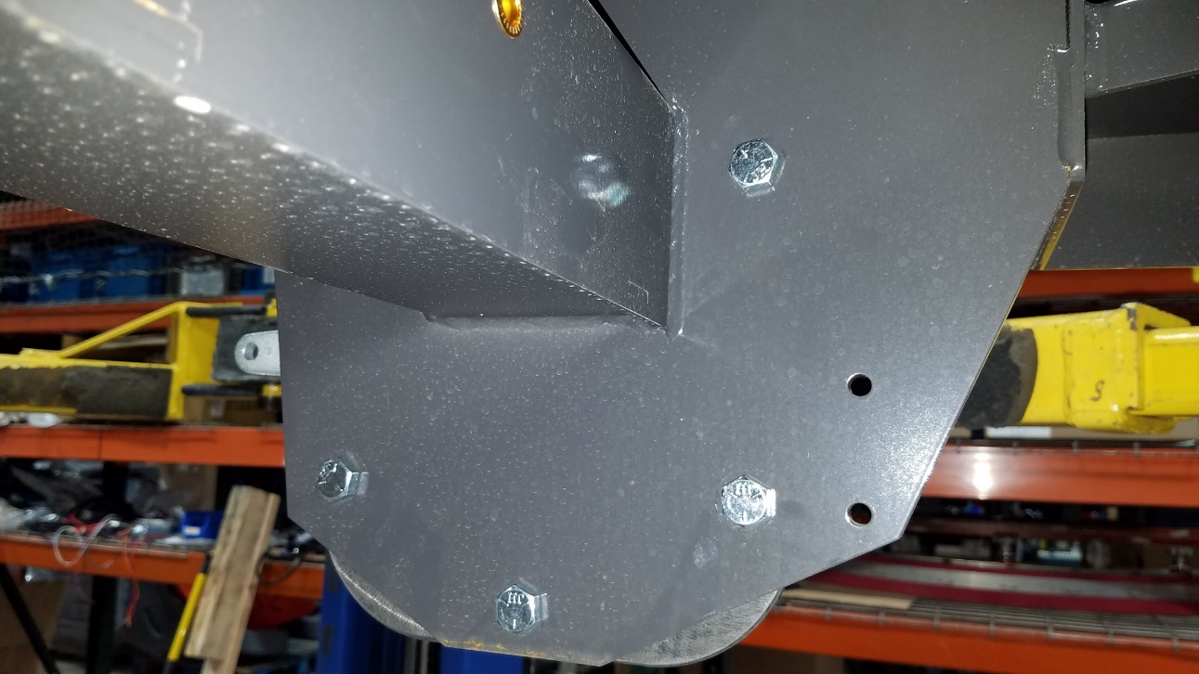
Brakes & Cable Pg 1 of 5
(2)730316
(6)712047
(6)711376
Install brake axle (730316) using 6 screws (712047) and 6 nyloc nuts (711376)
Repeat on both sides

Slide 11
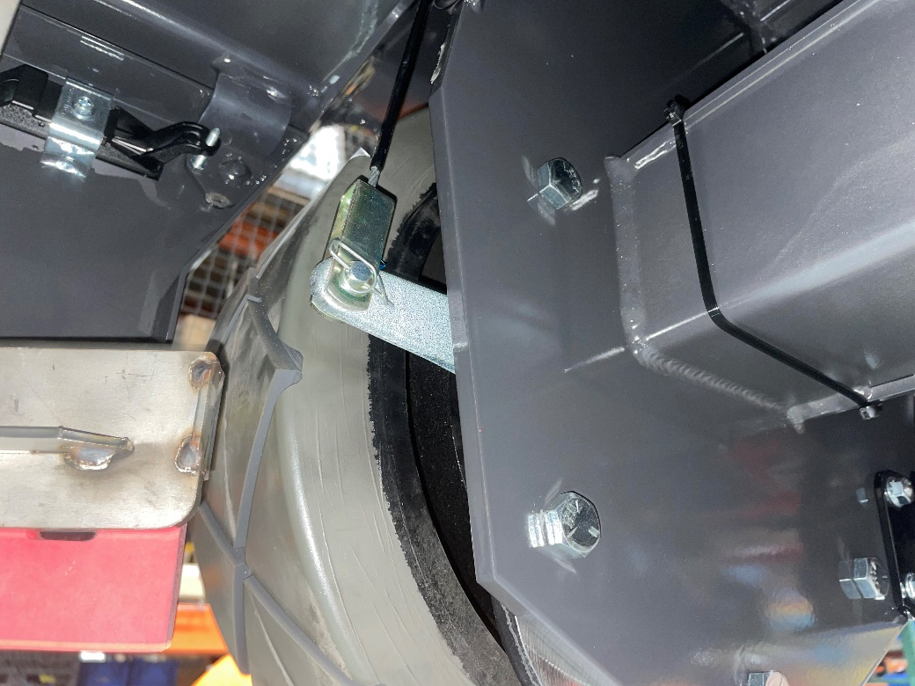
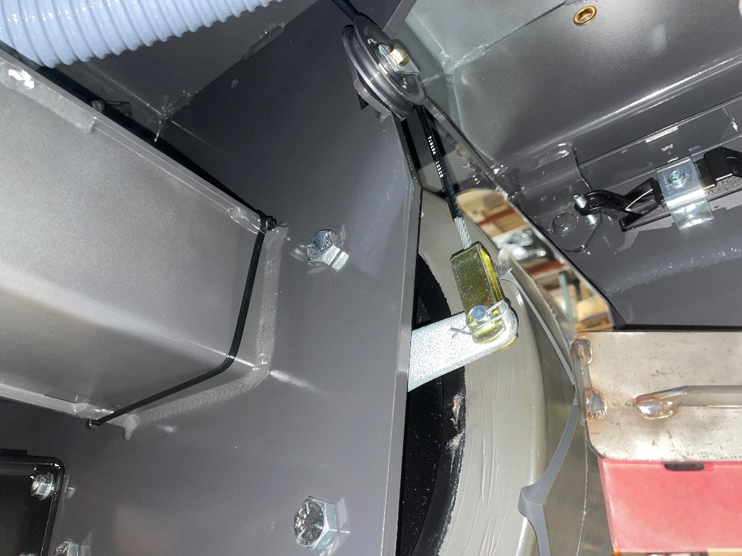
Brakes & Cable Pg 2 of 5
3400125
450034
718163 (RH)
3400125
450034
718164 (LH)
Install RH cable end of (718163) to the brake axle and secure it with pin (450034) and rue ring (3400125) RUE RING NEEDS TO BE ON THE TIRE SIDE**
Repeat the same process for the LH cable (718164) with pin (450034) and rue ring (3400125)

Slide 12
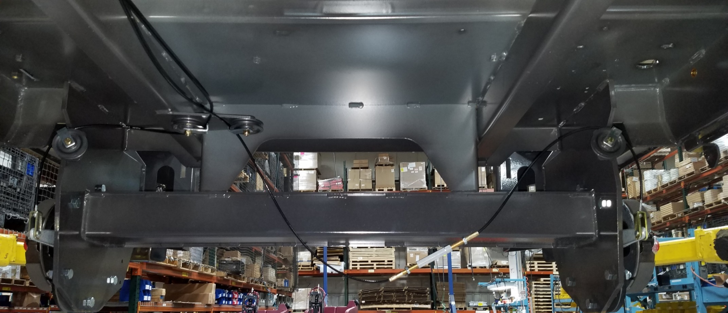
Brakes & Cable Pg 3 of 5
Pictured from front to rear
718163
718164
600338
3400075
600938
Connect the LH and RH brake cables with turnbuckle (600338), jam nut (3400075) to the RH cable, and jam nut with left hand thread (600938) to the LH cable

Slide 13
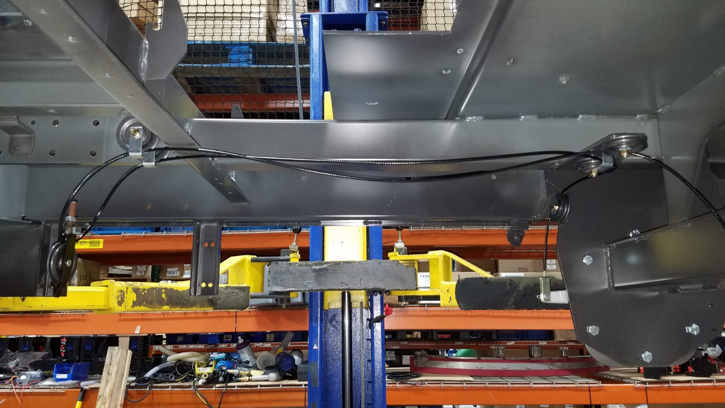
Brakes & Cable Pg 4 of 5
After LH and RH cables are connected, route the cables through the cable retainers as shown above

Slide 14
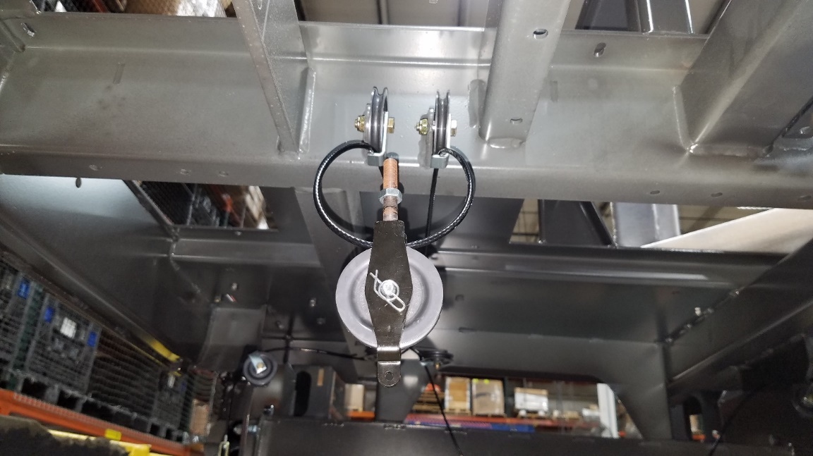
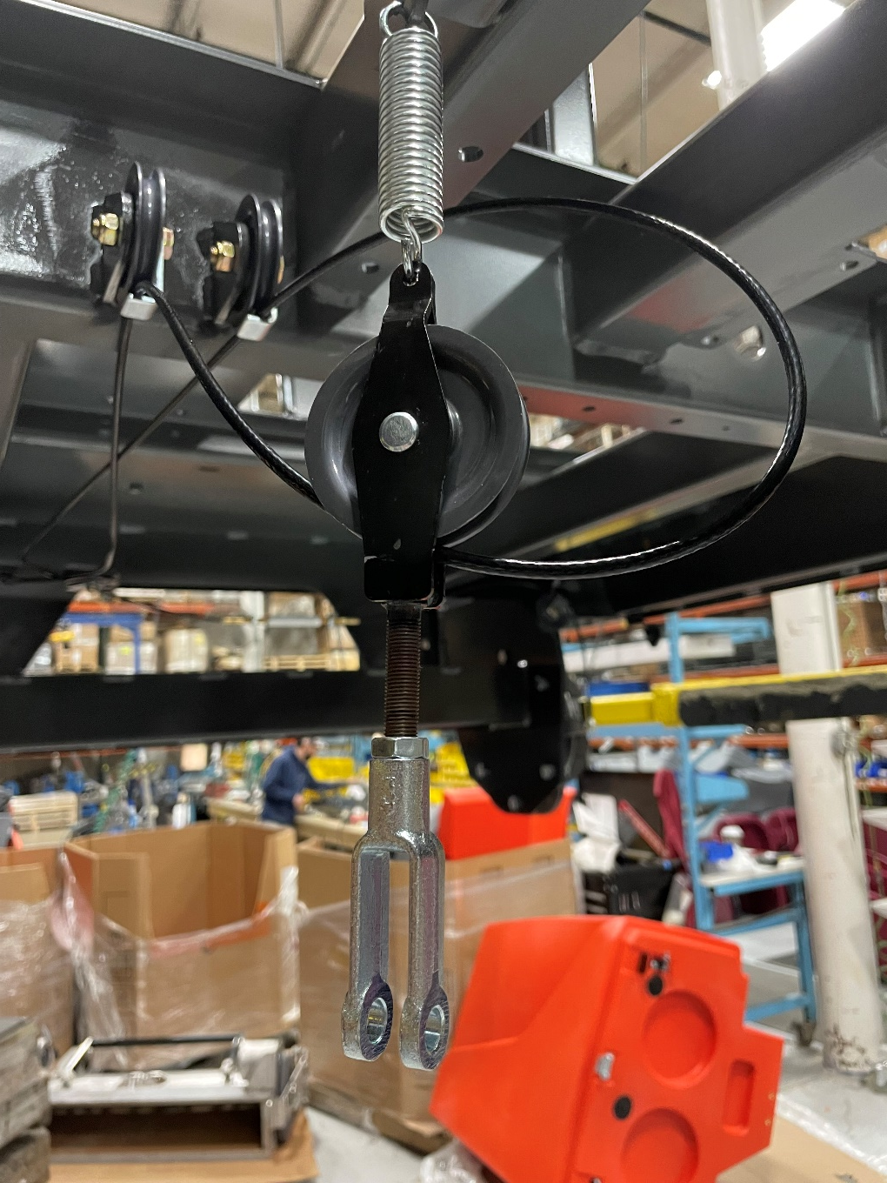
Brakes & Cable Pg 5 of 5
600127
600121
3400125
3400118
600114
600113
Route RH cable through clevis weldment (600121) and secure cable with pulley (600113), pin (3400118), spacer (600114)and rue ring (3400125), rue ring needs to be on the bottom.
Attach nut (3400075) and clevis (600813) to the threaded end of clevis weldment and tighten nut against clevis
Attach spring (600127) to clevis weldment (600121)
3400075
600813

Slide 15
Tires Material List & Locations
Component | Object Description | Usage Qty | Storage Bin
714501 | ASSEMBLY, POLYURETHANE TIRE | 2 | A1813H01
730358 | SPACER, 1.06 B, 1.75 OD, .105 T | 2 | FAS04C04
3400223 | NUT-HEX SLOTTED 1-20 | 2 | A1814E01
3400120 | PIN-COTTER 5/32 X 2.00 ZP | 2 | FAS01G09
383250 | GREASE CAP SPINDLE | 2 | A1907D07

Slide 16
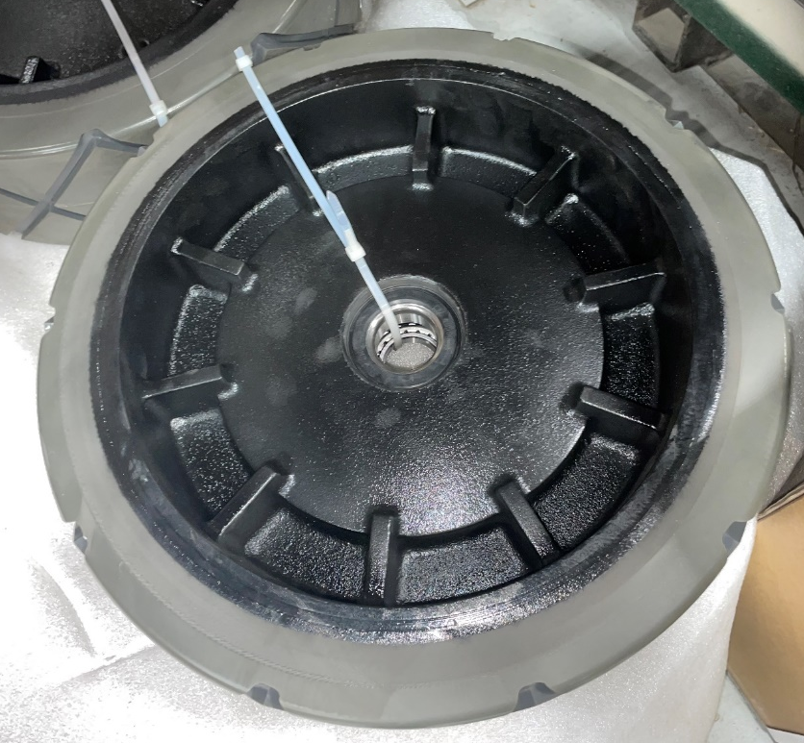
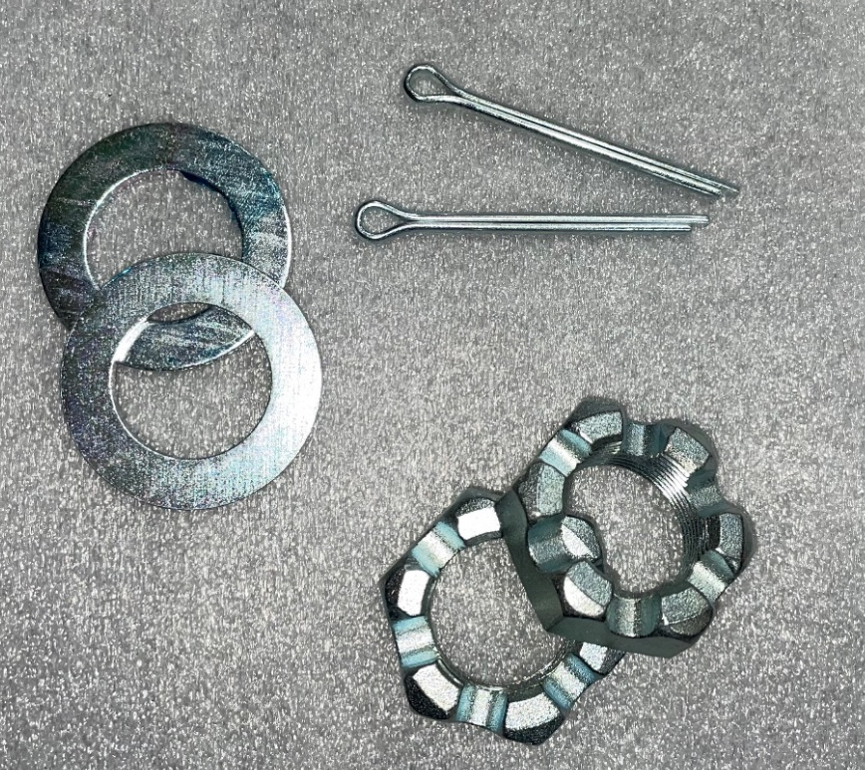
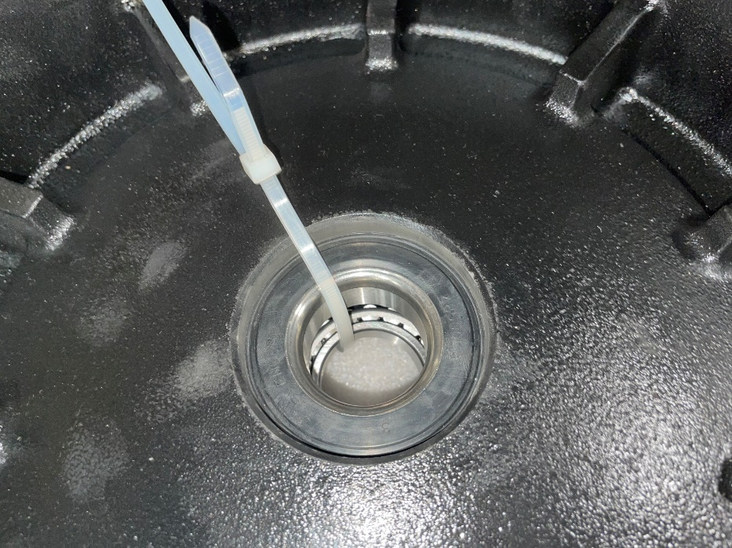
Tires Pg 1 of 4
Note: bearings come with wheels

Slide 17
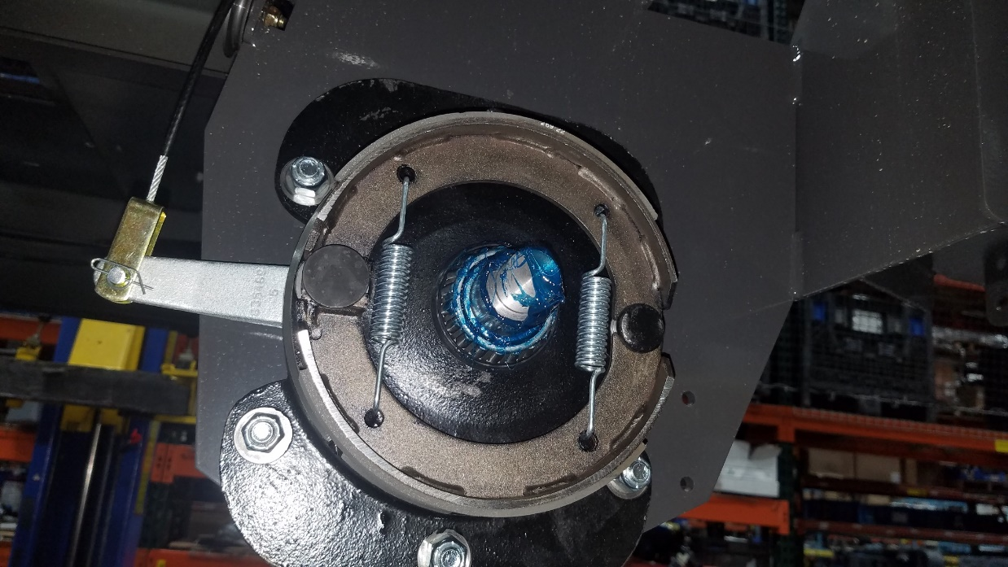
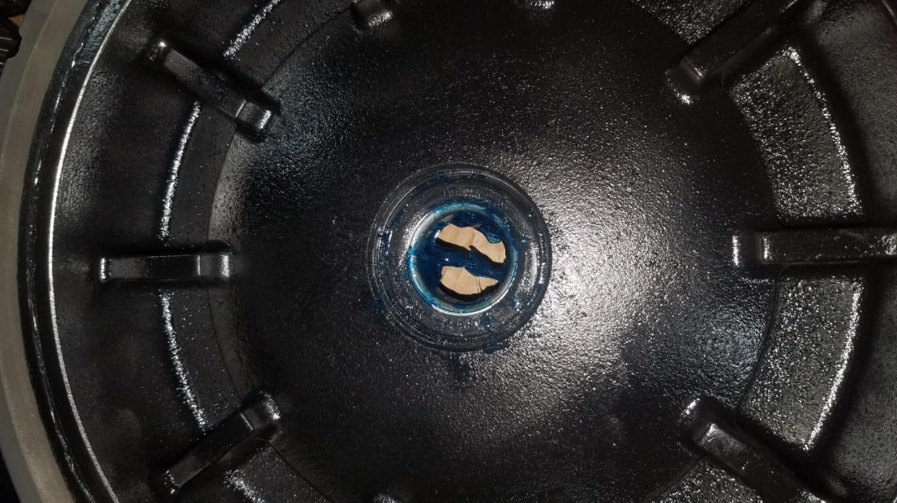
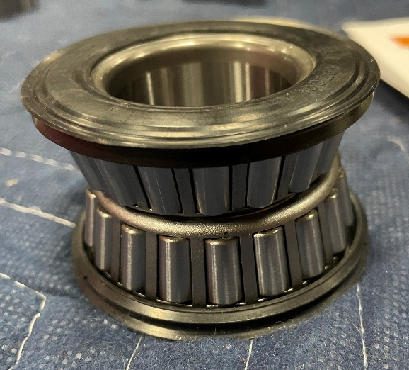
Tires Pg 2 of 4
Grease bearing and slide onto wheel hub as shown with the wider side towards the hub
After first greased bearing is on wheel hub, install tire (714501)
Slide on second bearing with the small sides facing each other (picture for ref)
Order of installation:
Bearing
Wheel
Bearing
Washer
Castle nut
Cotter pin
Bearing
(2)714501
Note: bearing orientation

Slide 18
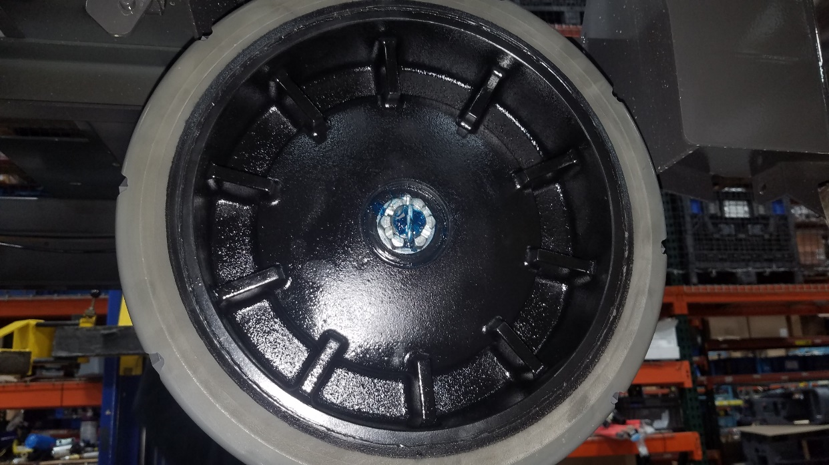
Tires Pg 3 of 4
(2)730358
(2)3400223
(2)3400120
Note: torque to 100 ft-lbs
Install washer (730358) and castle nut (3400223)
  Torque castle nut to 100 ft-lbs
After being torqued, install cotter pin (3400120)

Slide 19
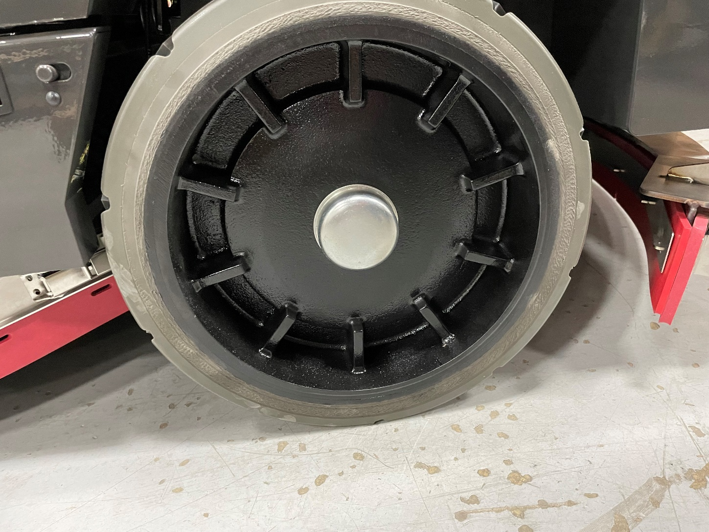
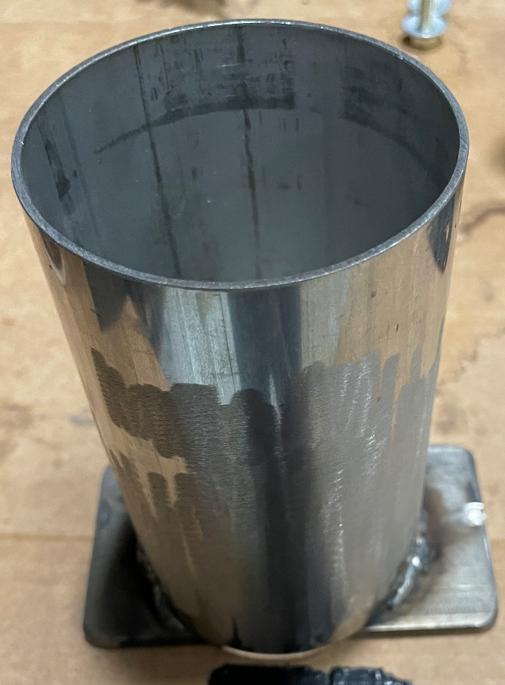
Tires Pg 4 of 4
(2)383250
Install hub cap (383250) onto wheel, make sure to use the hub cap tool created to not damage the wheel during installation
Repeat all steps on other side of machine

Slide 20
Scrub Deck Weldments Material List & Locations
Component | Object Description | Usage Qty | Storage Bin
718004 | WELDMENT, RH FRAME MNT | 1 | A1912E07
718005 | WELDMENT, LH FRAME MNT | 1 | A1912E06
718023 | SCR-HH M12-1.75 X 40 SS | 8 | FAS13J05
730605 | NUT-NYLOC M12-1.75 SS | 8 | FAS04H06
730608 | WASHER-FLAT M12 SS | 4 | FAS04H09
719486 | HEAD WEIGHT SPRING BRACKET | 2 | A1912D01
719487 | HEAD WEIGHT SPRING TENSIONER | 2 | A1814E01
719490 | SCR-HH, 3/8-16 X 4.50 ZP GR 5 FULL THRD | 2 | FAS12J03
712301 | WASHER-FLAT 3/8 X .87 X .06 ZP | 2 | FAS09J01

Slide 21
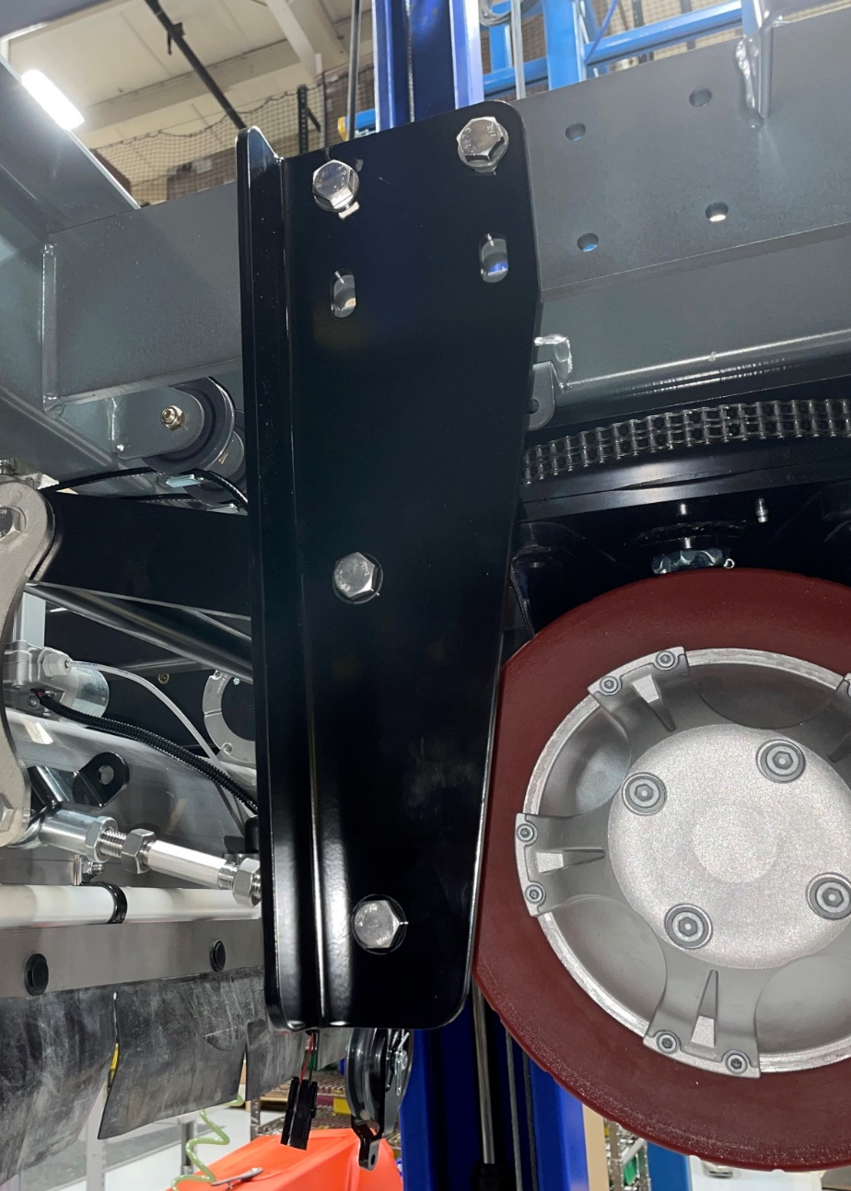
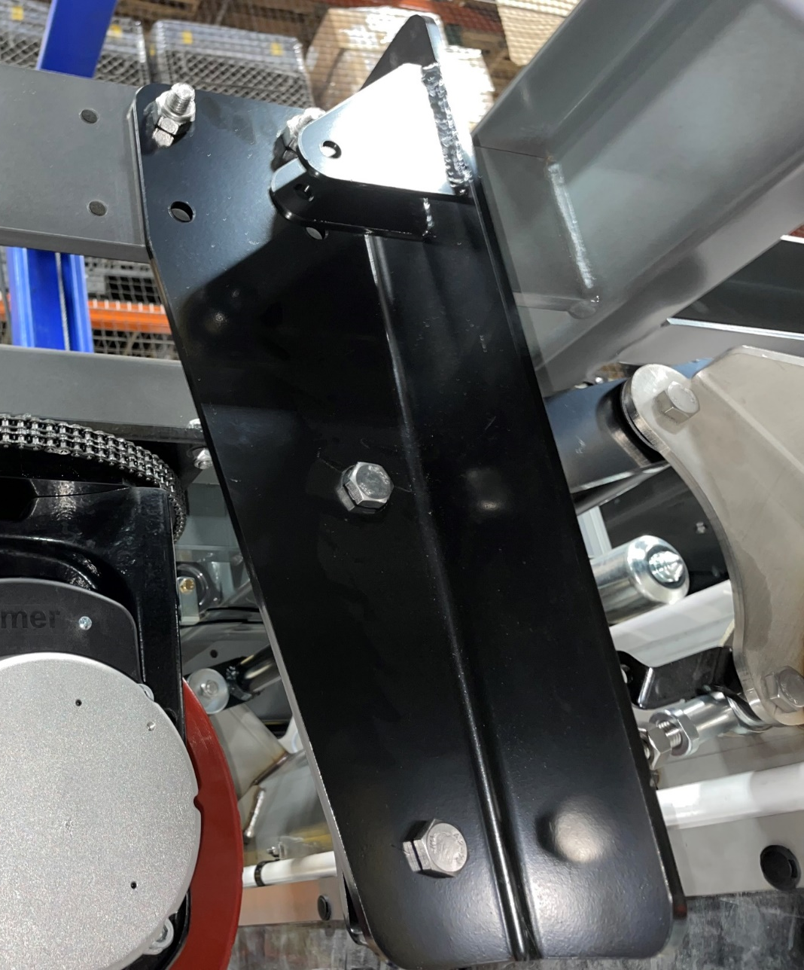
Scrub deck weldments Pg 1 of 2
RH
LH
(2)718023
(2)730608
(2)730605
(2)718023
(2)730605
718004
718005
Note: Washers only used on weldment 718004.
RH weldment top needs to be flush with frame
Install RH scrub deck weldment (718004) onto frame with 2 (718023) bolts, 2 (730608) washers, and 2 (730605) nyloc nuts
Install LH scrub deck weldment (718005) onto frame with 2 (718023) bolts and 2 (730605) nyloc nuts

Slide 22
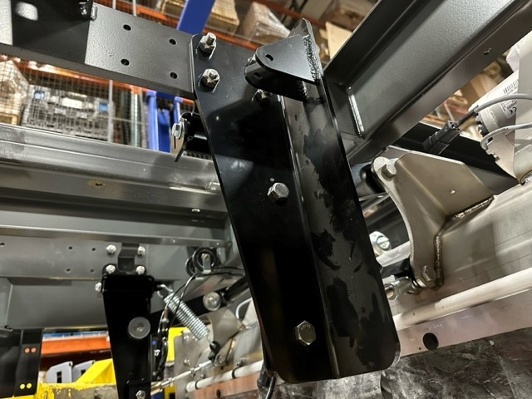
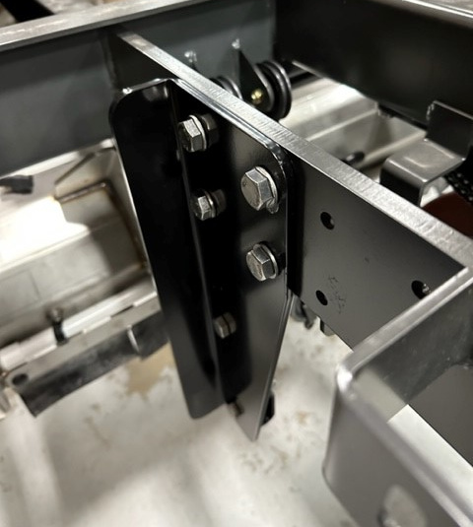
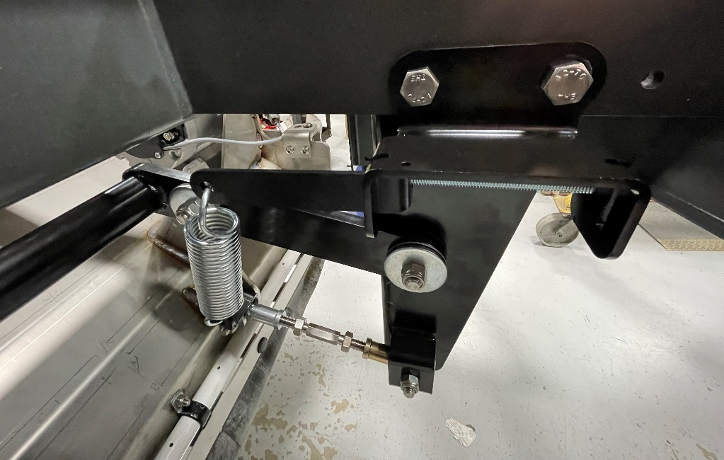
Scrub deck weldments Pg 2 of 2
RH
LH
(2)718023
(2)730605
(2)718023
(2)730608
(2)730605
Install head weight spring bracket (719486) as well as head weight spring tensioner (719487), screw (719490), and washer (712301) on each side
(2)719486
(2)719487
(2)719490
(2)712301

Slide 23
Actuator Material List & Locations
Component | Object Description | Usage Qty | Storage Bin
714592-1 | ACTUATOR ASSY, SCRUB HEAD | 1 | A1912E04
718014 | SCR-HH 1/2-13 X 7.50 18-8 SS | 2 | FAS13J07
718180 | SPRING, .813 OD, .135W, 3.00L SS | 2 | A1814C01
719505 | SPRING, COMPRESS, .875OD .12W 3.00L SS | 2 | A1814C01
718013 | CHANNEL, SPRING MNT | 1 | A1912D04
718178 | NUT, HEX JAM 1/2-13 ZP | 2 | FAS13I03
711376 | NUT-NYLOC 1/2-13 ZP | 2 | FAS08B01
740830 | SW-SNAP SPST NO/NC CONTACTS FLAT LEVER | 1 | A1814C01
710307 | SCR-PHMS 6-32 X 1.00 ZP | 2 | FAS02I08
711371 | NUT-NYLOC 6-32 ZP | 2 | FAS03C10
730602 | PIN-CLEVIS .375 X 2.75 ZP | 1 | FAS04H04
3337258 | STANDOFF - .38 ID X .75 OD X .50 LG | 1 | A1814C01
712301 | WASHER-FLAT 3/8 X .87 X .06 ZP | 1 | FAS09J01
3400125 | RING-RUE 3/8 | 1 | MIN02J05

Slide 24
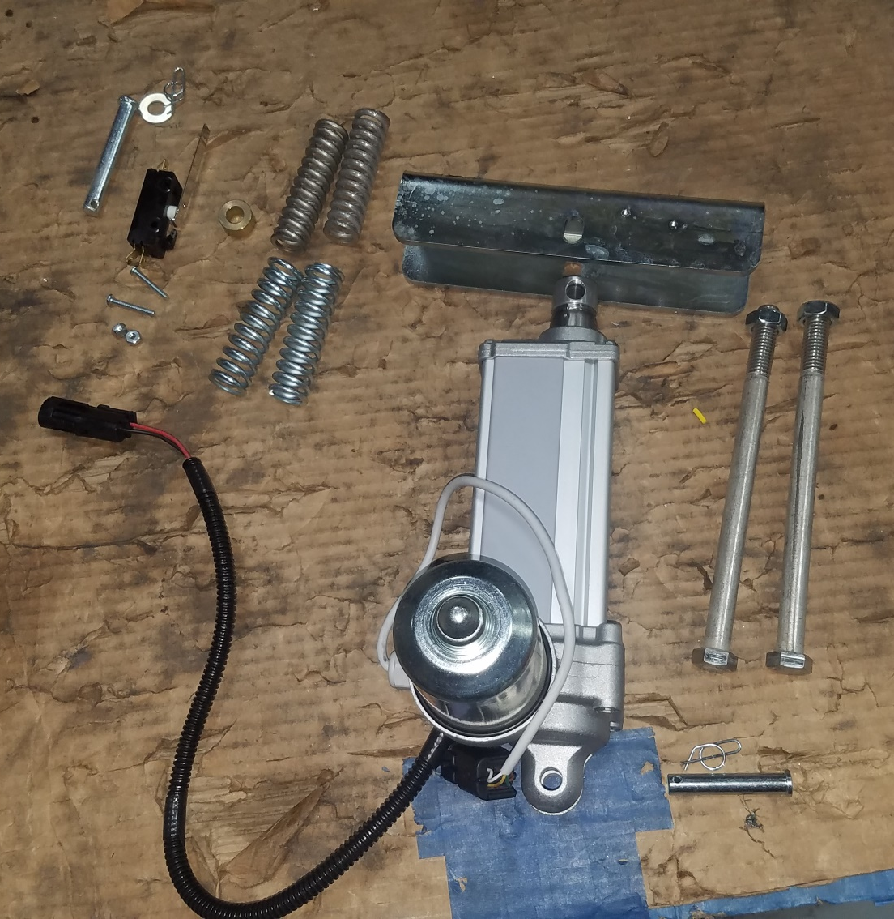
Actuator Pg 1 of 3

Slide 25
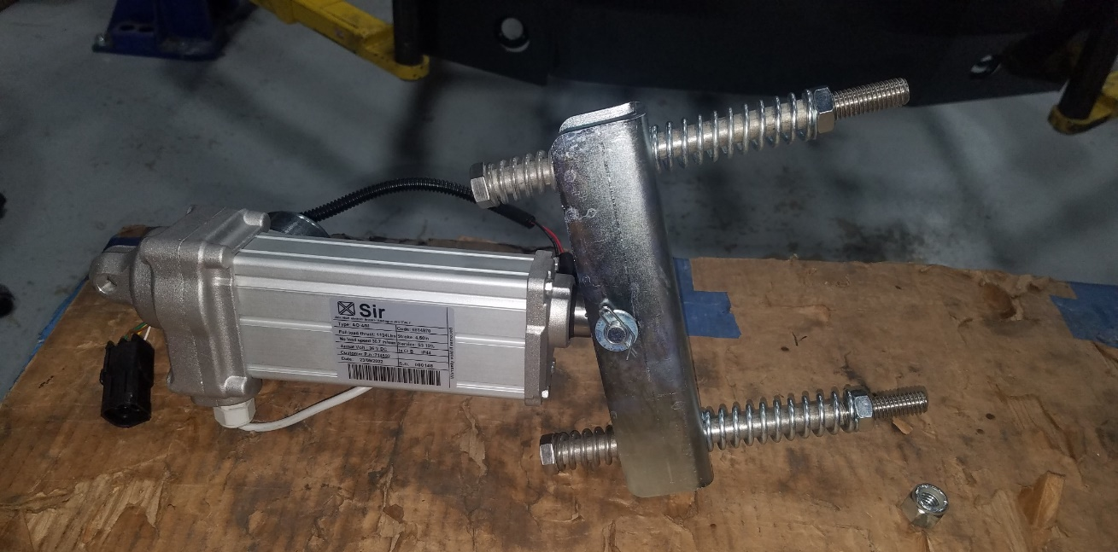
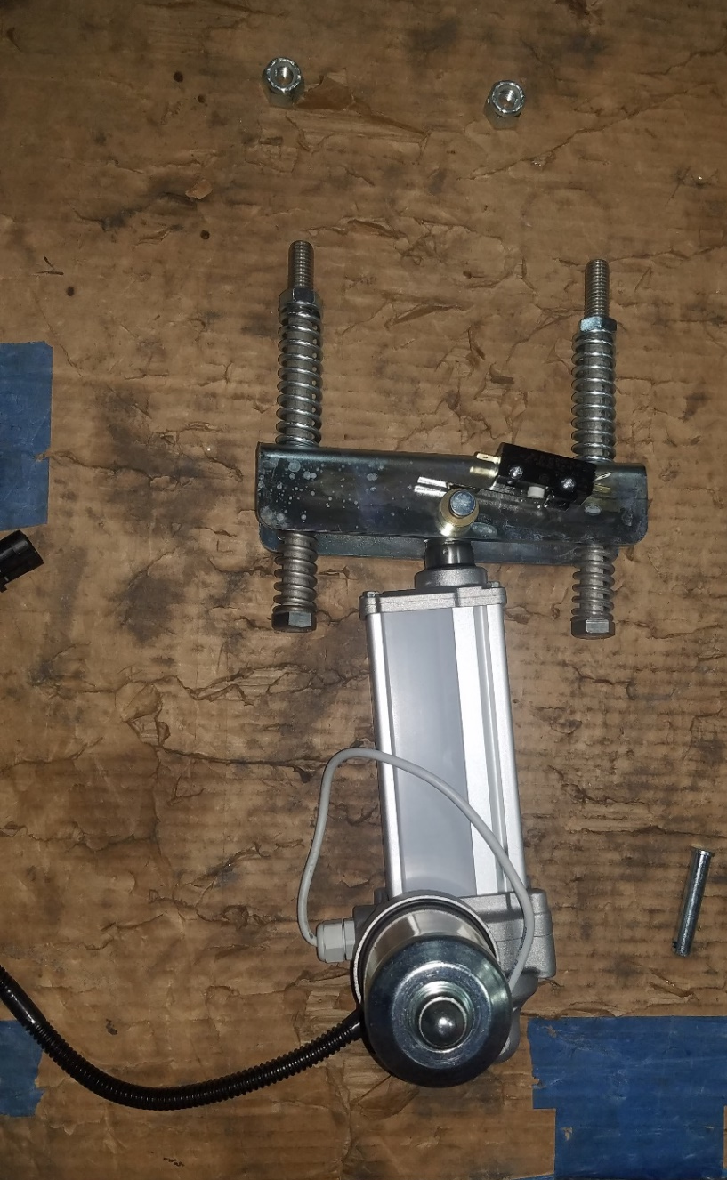
Actuator Pg 2 of 3
740830
(2)710307
(2)711371
730602
3337258
712301
3400125
(2)718178
718013
(2)719505
(2)718014
(2)718180
Assemble top portion of actuator by installing spring (718180) onto screw (718014)
Slide screw (718014) through the open end of spring channel (718013)
Slide spring (719505) onto screw (718014) and secure springs with jam nut (718178)
  Repeat process on other side of spring channel
Install flat lever contact (740830) onto spring channel by securing it with 2 screws (710307) and 2 nyloc nuts (711371)
Connect spring channel (718013) to the actuator assembly (714592-1) by installing pin clevis (730602), standoff (3337258), washer (712301), and rue ring (3400125)
714592-1

Slide 26
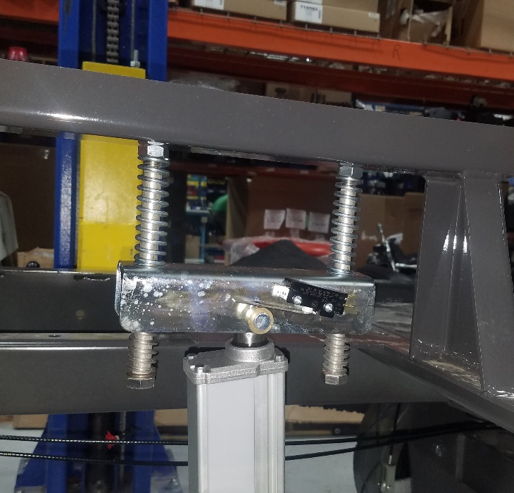
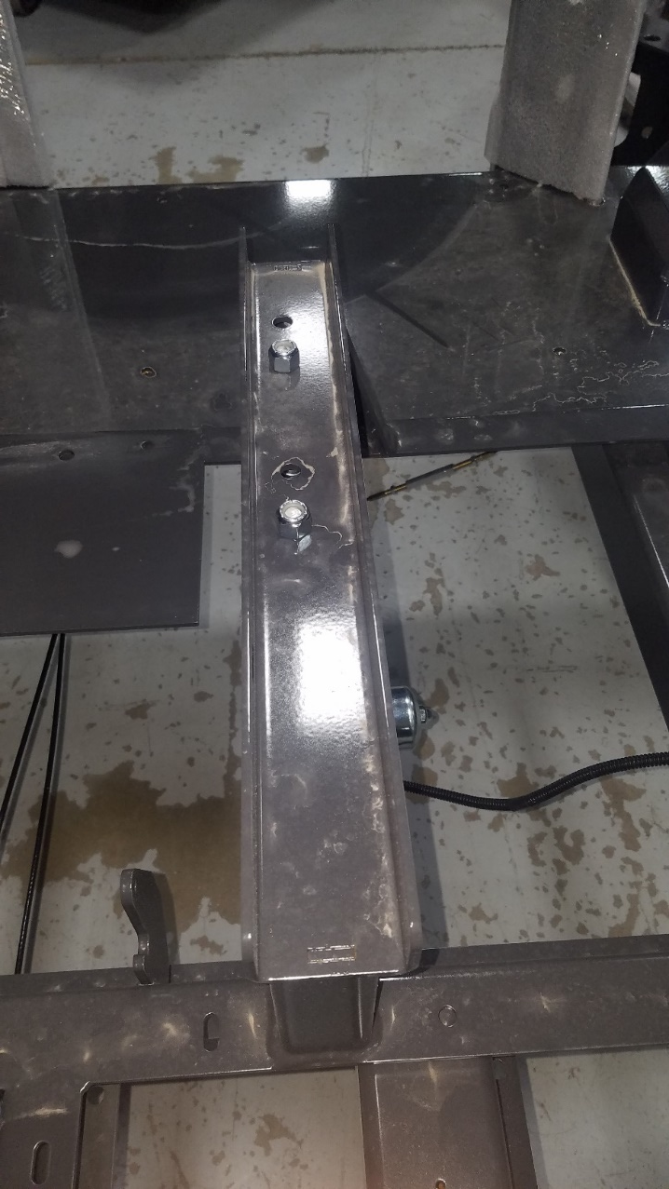
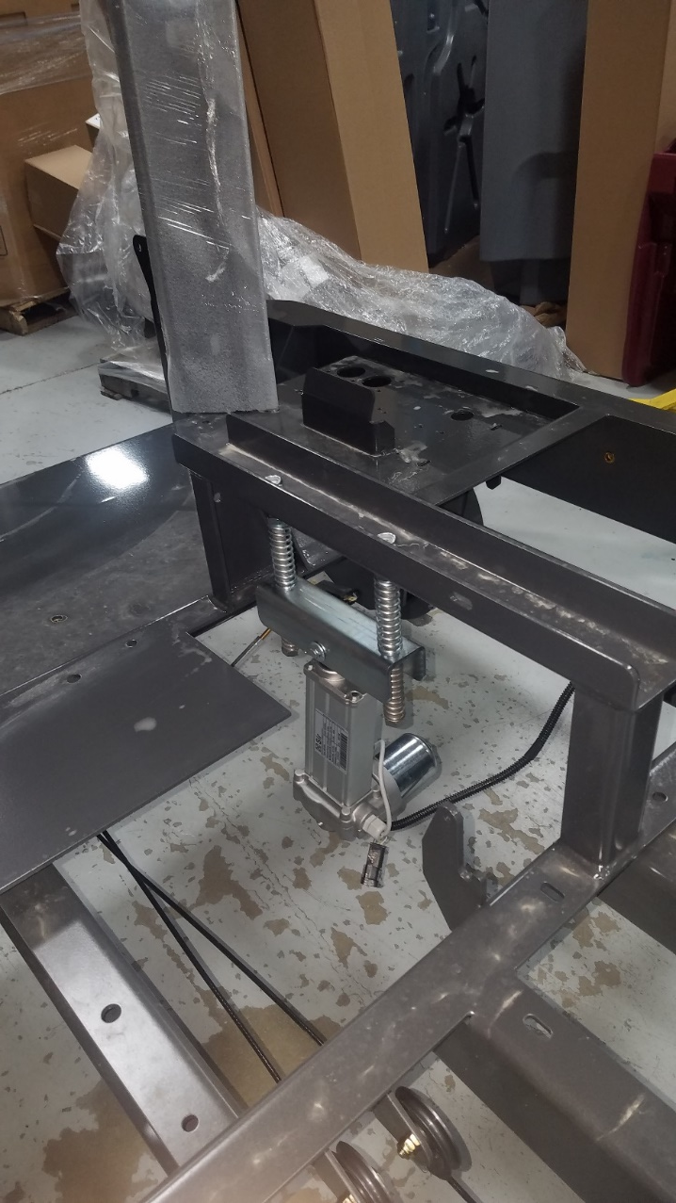
Actuator Pg 3 of 3
Note: Secure nuts with minimum 2 threads
(2)711376
Install actuator assembly (714592-1) to the frame with 2 nyloc nuts (711376)
Note: orientation of actuator, if reversed it will cause damage

Slide 27
Scrub Deck Material List & Locations
Component | Object Description | Usage Qty | Storage Bin
B7-TG-S725 | Scrub Deck | 1
714586 | PIN, CLEVIS, 10MM | 1 | A1814C01
3400125 | RING-RUE 3/8 | 1 | MIN02J05
719489 | SPRING | 2 | A1912D02
714648 | SCR-HH M12-1.75 X 55 SS | 2 | FAS13J08
730605 | NUT-NYLOC M12-1.75 SS | 2 | FAS04H06
714649 | SPACER, .484 B 1.00 OD .179 T | 4 | A1814F01

Slide 28
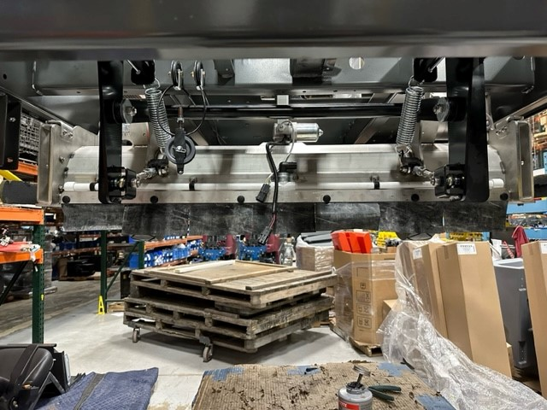
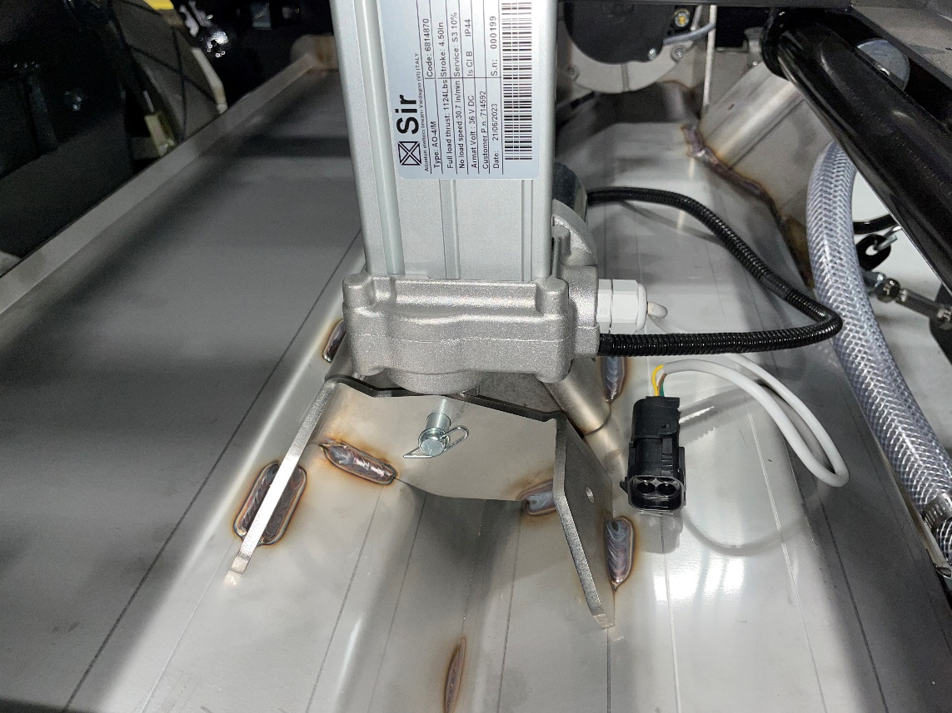
Scrub Deck Pg 1 of 3
B7-TG-S725
714586
3400125
Use table lift to line up and connect scrub deck to actuator with pin (714586) and rue ring (3400125)

Slide 29
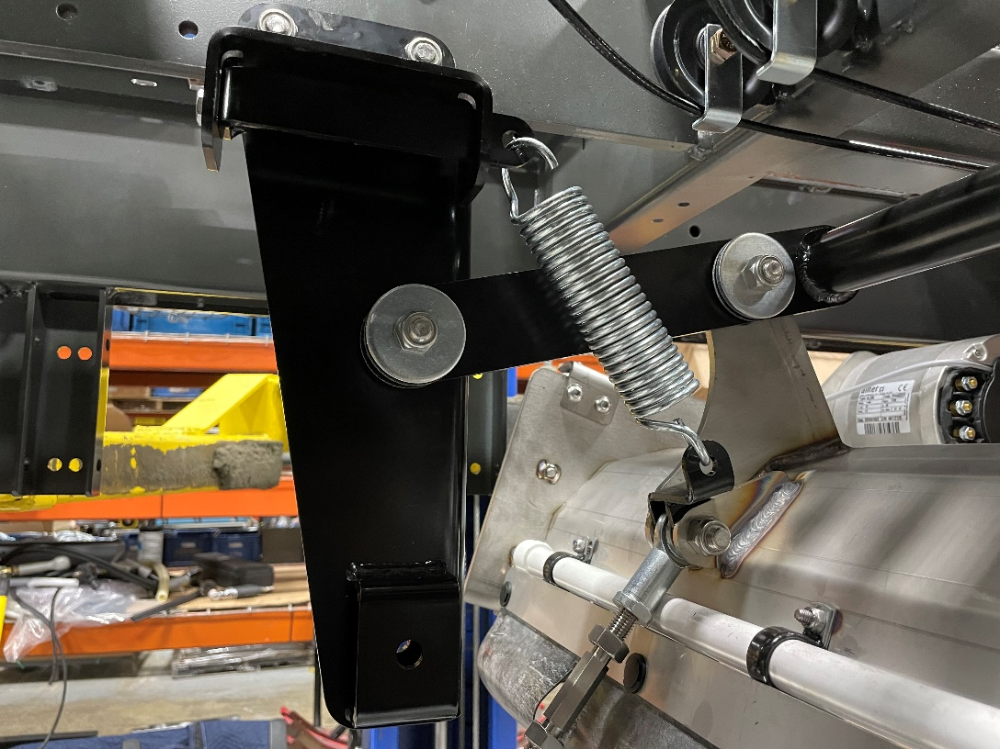
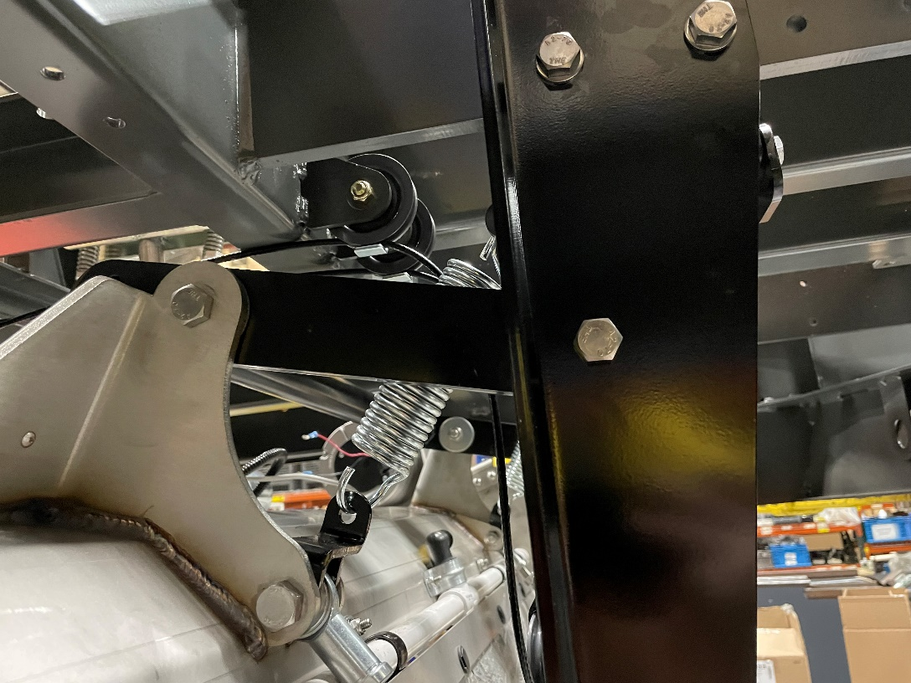
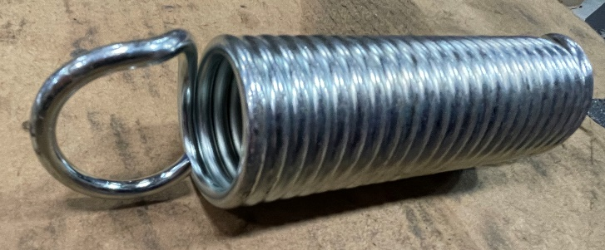
Scrub Deck Pg 2 of 3
(2)719489
Cut roughly ¼” from each side to install
Using existing hardware provided from the scrub deck sub, connect trailing arms of scrub deck to the scrub deck weldments
Connect 2 springs (719489) on each side of the scrub deck to the weldments
  Cut roughly ¼” from the spring on each side to be able to install
Adjust tensioner so that it is tightened all the way

Slide 30
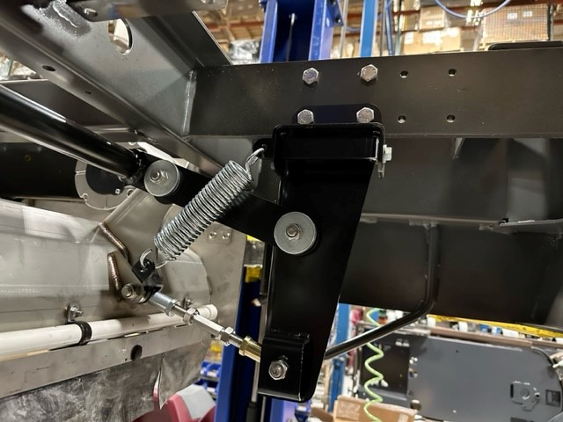
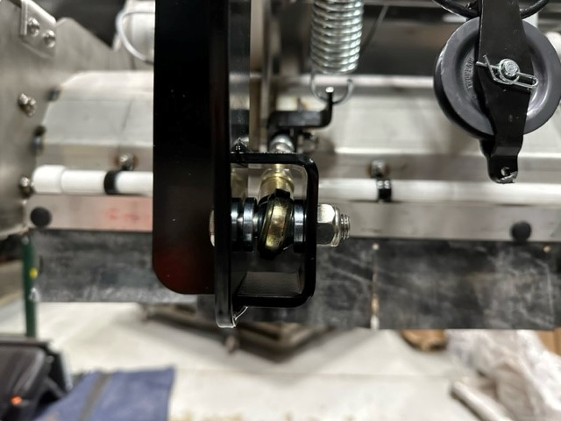
Scrub Deck Pg 3 of 3
Attach scrub deck linkages to the bottom of the scrub deck weldments by securing with screw (714648), spacer (714649), and nyloc nut (730605) on each side
(2)714648
(2)730605
(4)714649

Slide 31
Drive Motor Material List & Locations
Component | Object Description | Usage Qty | Storage Bin
L1-TG-S714C | Drive Motor | 1
730878 | SCR-HH M10-1.50 X 30 SS | 4 | FAS07B08
730339 | NUT-NYLOC M10-1.50 SS | 4 | FAS04F11
718427 | BRACKET, DRIVE MOTOR HARNESS | 1 | A1814E01
600945 | WASHER-LOCK M10 | 1 | FAS01E09
730323 | SCR-HH M10-1.50 X 60 SS | 1 | FAS04F10
730344 | WASHER-FLAT M10 SS | 1 | FAS04G01

Slide 32
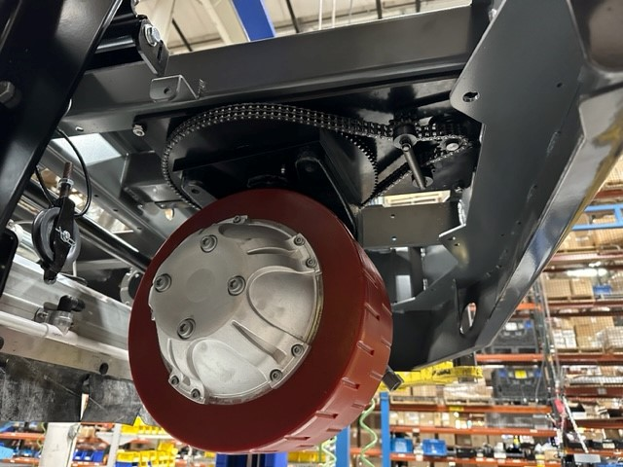
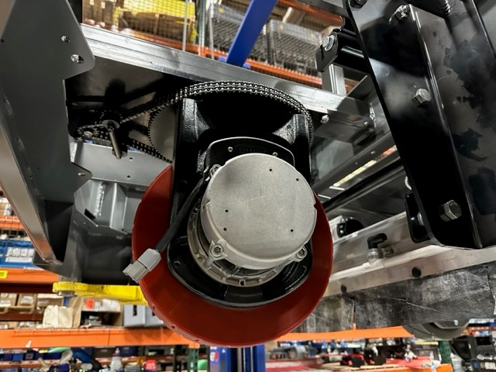
Drive Motor Pg 1 of 3
L1-TG-S714C
Using the hydraulic lift table, line up drive motor underneath the frame

Slide 33
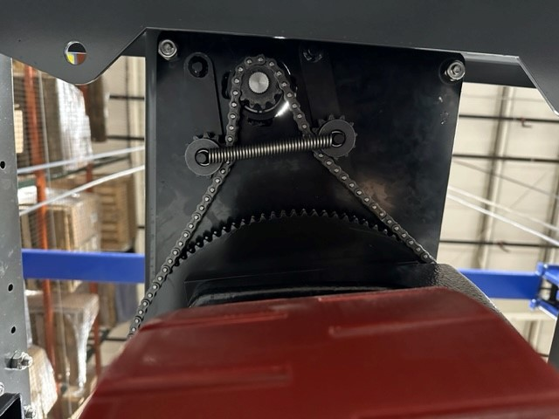


Drive Motor Pg 2 of 3
(4)730878
(4)730339
Secure drive motor to frame with the following hardware on all four corners, screw (730878) and nyloc nut (730339)

Slide 34

Drive Motor Pg 3 of 3
718427
600945
730323
730344
Install bracket (718427) onto drive motor with screw (730323), washer (730344), and lock washer (600945)

Slide 35
Counterweights Material List & Locations
Component | Object Description | Usage Qty | Storage Bin
3400086 | WASHER-FLAT 1/2 ZP | 2 | FAS08H05
3400381 | SCR-FHSCS 3/8-24 X 1.75 ZP | 2 | FAS12D02
711376 | NUT-NYLOC 1/2-13 ZP | 2 | FAS08B01
3400342 | NUT-NYLOC 3/8-24 ZP | 2 | FAS09E05
712163 | SCR-FHSCS 3/8-16 X 1.375 BLACK OXIDE | 14 | FAS06H08
718454 | COUNTERWEIGHT, NAUTILUS E, 26LB | 8 | A1811H01
718455 | SCR-HH 1/2-13 X 7" GR5 ZP | 2 | FAS06I03

Slide 36



Counterweights Pg 1 of 2
718454
Note: Tap all 3/8 holes with 3/8-16 tap before installation
3400381
712163
3400086
711376
718455
3400342

Slide 37



Counterweights Pg 2 of 2
(8)718454
(14)712163
Top of counterweights
(2)3400381
(2)3400342
(2)711376
(2)718455
(2)3400086
Secure first counterweight (718454) to the frame using 2 screws (3400381) and 2 nyloc nuts (3400342)
Alternate the counterweights by flipping every other one and secure remaining counterweights with 2 screws (712163) EACH (total 14)
  Make sure holes line up, holes will not line up if counterweights are not flipped the right way.
Secure all counterweights together with 2 screws (718455), 2 washers (3400086), and 2 nyloc nuts (711376)

Slide 38
Side Squeegee Material List & Locations
Component | Object Description | Usage Qty | Storage Bin
B7-TG-S710RH | Side Squeegee RH | 1
B7-TG-S710LH | Side Squeegee LH | 1
711679 | PIN-CLEVIS 3/8 X .750 ZP | 4 | MIN01G02

Slide 39


Side Squeegee Pg 1 of 1
(4)711679
B7-TG-S710RH
B7-TG-S710LH
Install squeegees using hardware provided in sub
Install LH and RH side squeegees with the hardware provided in the sub
Install 2 pin clevis (711679) to each squeegee and connect springs

Slide 40
Scrub Door Material List & Locations
Component | Object Description | Usage Qty | Storage Bin
3300526 | BUMPER-RUBBER 1/4 ID X 1/8 THK | 4 | A1814F01
718076 | WELDMENT, RH SCRUB DOOR | 1 | A1810G02
718077 | WELDMENT, LH SCRUB DOOR | 1 | A1810G01
731433 | LATCH-LARGE-NAUTILUS | 2 | A1802F01
718217 | HINGE, SH DOOR | 2 | A1814H01
730958 | SCR-HH M10-1.50 X 25 SS FULL THREAD | 4 | FAS07C06
3400385 | WASHER-CONICAL SPRING 3/8 | 4 | MIN01I08
600936 | NUT-FLANGE WIZZ M10-1.50 ZP CLASS 8 | 4 | FAS08D01
730344 | WASHER-FLAT M10 SS | 4 | FAS04G01
730339 | NUT-NYLOC M10-1.50 SS | 4 | FAS04F11

Slide 41

Scrub Door Pg 1 of 3

Slide 42



Scrub Door Pg 2 of 3
(2)731433
(RH)718076
(LH)718077
Hardware included with latch
(4)3300526
Install 2 rubber bumpers (3300526) on each scrub door (718076) & (718077) in the locations shown in the pictures
Install latch (731433) on each scrub door

Slide 43



Scrub Door Pg 3 of 3
(4)730958
(4)3400385
(4)600936
(4)730344
(4)730339
(2)718217
Note: Blue line on hinge (718217) attaches to frame
Install hinges (718217) onto both sides of frame, making sure that the blue line on the hinge is attached to the frame using 2 screws (730958), 2 conical washers (3400385), and 2 flange nuts (600936).
Install door on other side of hinge on both sides of machine using 2 washers (730344) and 2 nyloc nuts (730339)

Slide 44
Headlights Material List & Locations
Component | Object Description | Usage Qty | Storage Bin
691001-1 | HEADLIGHT ASSY, 4X6 LED WITH DRL | 2 | A1911D01
17526120 | CABLE TIE MOUNT W/ADHESIVE 1"X1" | 3 | A1802C02
712167 | SCR-HH M4-0.7 X 16 THREAD FORMING | 8 | FAS12J10
711599 | WASHER-FLAT .187 X 1.00 X .06 | 8 | FAS03G09
719612 | HARNESS, HEADLIGHTS TRUE GRIT CYL | 1 | A1911C05

Slide 45


Headlights Pg 1 of 3
(8) 711599
(8) 712167
(2) 691001-1

Slide 46


Headlights Pg 2 of 3
(8) 711599
(8) 712167
(2) 691001-1
Install headlights (691001-1) onto frame by securing with 4 screws (712167) and 4 washers (711599) on each headlight assembly

Slide 47



Headlights Pg 3 of 3
(2)17526120
17526120
719612
Connect headlights with harness (719455) and route wiring as shown above
Secure harness and zip tie with 3 (17526120) cable tie mount w/adhesive 1"X1“

Slide 48
Tail Lights Material List & Locations
Component | Object Description | Usage Qty | Storage Bin
719242 | SHIELD, TAIL LIGHT | 2 | A1814D01
600698-2 | ASSY, LIGHTS, TAIL, BRK, RED LED | 2 | A1907C04
719611 | HARNESS, TAIL LIGHTS TRUE GRIT CYL | 1 | A1911C04
710305 | SCR-PHMS 6-32 X .75 ZP | 4 | FAS03D08
711371 | NUT-NYLOC 6-32 ZP | 4 | FAS03C10
711599 | WASHER-FLAT .187 X 1.00 X .06 | 4 | FAS03G09

Slide 49


Tail Lights Pg 1 of 3
(2)719242
(2)600698-2
(4)710305
(4)711371
(4)711599

Slide 50


Tail Lights Pg 2 of 3
(2)710305
(2)711371
(2)711599
600698-2
719242
Install tail light shield (719242) and tail light assembly (600698-2) to the frame by securing with 2 screws (710305), 2 washers (711599), and 2 nyloc nuts (711371)
Repeat on both sides

Slide 51


Tail Lights Pg 3 of 3
719611
Attach harness (719611) and route as shown along the rear of the frame

Slide 52
Rear Bumper Material List & Locations
Component | Object Description | Usage Qty | Storage Bin
L1-TG-S719 | REAR BUMPER | 1
B4-TG-S715 | BUMPER LATCH | 1
730883 | SPACER, BUMPER | 4 | A1804B02
730882 | BEARING, SPHERICAL | 2 | A1814F01
714606 | PIN, CLEVIS, 1/2 X 2.25 SS | 2 | FAS13I05
600578 | RING-RUE .50 ZP | 2 | FAS08B05
600117 | BUMPER, 1.0 OD, .50 GROMMET, RUBBER | 2 | A1814D01
714607 | MOUNT, GAS STRUT | 2 | A1814E01
11039567 | SCR-HH M8-1.25 X 25 SS | 4 | FAS07F06
3400384 | WASHER-CONICAL SPRING 5/16 | 10 | MIN01I07
600934 | NUT-FLANGE WIZZ M8-1.25 ZP | 4 | FAS08J02
714605 | GAS STRUT | 2 | A1912D03
717030 | SCR-HH M8-1.25 X 20 SS | 6 | FAS08E03
3300376 | STUD-BALL GAS SPR 5/16-18 THRD .391DIA. | 2 | A1802E01
712683 | NUT-NYLOC 5/16-18 SS | 2 | FAS05D08
714545 | MOUNT, GAS STRUT | 2 | A1814E01
3400384 | WASHER-CONICAL SPRING 5/16 | 2 | MIN01I07
717030 | SCR-HH M8-1.25 X 20 SS | 2 | FAS08E03
714537 | WELDMENT, STRIKER | 1 | A1912E01

Slide 53


Rear Bumper Pg 1 of 7

Slide 54



Rear Bumper Pg 2 of 7
Rue ring needs to be on inside
(4)730883
(2)730882
(2)714606
(2)600578
Frame
Line up bumper (L1-TG-S719) with the frame and secure bumper with pin clevis (714606), 2 spacers (730883), bearing (730882), and rue ring (600578)
  Repeat on both sides of bumper
L1-TG-S719

Slide 55


Rear Bumper Pg 3 of 7
(2)714607
(2)600117
(4)11039567
(4)3400384
(4)600934
Install rubber bumper (600117) on each side of frame as shown above
Install bracket (714607) to frame on both sides securing with 2 screws (11039567), 2 conical washers (3400384), and 2 flange nuts (600934)

Slide 56


Rear Bumper Pg 4 of 7
(2)717030
(2)3400384
714545
Install gas strut mount (714545) by securing with 2 screws (717030) and 2 conical washers (3400384)
  Repeat on other side of bumper
NOTE: Repeat on other side

Slide 57

Rear Bumper Pg 5 of 7
Install ball stud (3300376) and secure with nyloc nut (712683) on both sides of machine (highlighted in yellow)
Install gas strut onto the two locations shown below on both sides of the bumper (L1-TG-S719) and bracket (714607)
(2)3300376
(2)712683
(2)714605

Slide 58


Rear Bumper Pg 6 of 7
(2)717030
(2)3400384
B4-TG-S715
Install bumper latch onto frame by securing with 2 screws (717030) and 2 conical washers (3400384)

Slide 59




Rear Bumper Pg 7 of 7
(2)717030
(2)3400384
Install striker (714537) on bumper with 2 screws (717030) and 2 conical washers (3400384)
Verify that the bumper latch and striker line up together with no rubbing and are functioning properly
  There should be no play in the bumper when latched together, adjust as needed with the nuts highlighted in yellow
714537
Frame
Bumper

Slide 60
Squeegee Lift Group Material List & Locations
Component | Object Description | Usage Qty | Storage Bin
B7-TG-S711 | SQUEEGEE LIFT | 1
B7-TG-S712 | SQUEEGEE LINKAGE | 1
600852 | INSERT-M8-1.25 .188 GRIP ZP | 2 | MIN02D07
11039328 | SCR-HH M10-1.50 X 25 SS DIN 933 | 6 | FAS05F08
730339 | NUT-NYLOC M10-1.50 SS | 2 | FAS04F11
3400385 | WASHER-CONICAL SPRING 3/8 | 4 | MIN01I08
717030 | SCR-HH M8-1.25 X 20 SS | 2 | FAS08E03
730742 | SPRING, EXT, .160 W 1.25 OD 10.25 L SS | 2 | A1814H01

Slide 61



Squeegee Lift Group Pg 1 of 6
(2)11039328
(2)600852
B7-TG-S711
(2)3400385
(2)11039328
Install 2 inserts (600852) onto sub assembly B7-TG-S711
Install 2 screws (11039328) to the squeegee lift as shown in the picture in the top right
Install 2 screws (11039328) and 2 conical washers (3400385) to the squeegee lift as shown in the bottom right picture

Slide 62


Squeegee Lift Group Pg 2 of 6
(2)11039328
(2)730339
Line up assembly with rear bumper and secure with 2 screws (11039328) and 2 nyloc nuts (730339) as shown in the top left picture
Secure mount/plate that had inserts installed with 2 conical washers (3400385) and 2 screws (717030) as shown in the bottom left picture
(2)3400385
(2)717030

Slide 63


Squeegee Lift Group Pg 3 of 6
B7-TG-S712
Screw on the rear portions of the linkages from assembly (B7-TG-S712) on both sides of rear bumper and squeegee lift as shown above

Slide 64



Squeegee Lift Group Pg 4 of 6
Adjust cable and nut so that the outer nut has at minimum 2 threads showing (highlighted in yellow)
  Tighten inner nut so that the cable does not come loose

Slide 65
Squeegee Lift Group Pg 5 of 6
Linkages needs to be adjusted to 5 ¼” from nut to nut
Adjust the linkages so that it is 5 ¼” from nut to nut on the linkages (highlighted in yellow in the picture)

Slide 66

Squeegee Lift Group Pg 6 of 6
Install spring (730742) on each side of the squeegee linkage as shown
(2)730742

Slide 67
Console Material List & Locations
Component | Object Description | Usage Qty | Storage Bin
L1-TG-S720C | CONSOLE | 1
718152 | STEERING SHAFT, MANUAL, LOWER | 1 | A1912F02
600936 | NUT-FLANGE WIZZ M10-1.50 ZP CLASS 8 | 2 | FAS08D01
3400385 | WASHER-CONICAL SPRING 3/8 | 2 | MIN01I08
730958 | SCR-HH M10-1.50 X 25 SS FULL THREAD | 2 | FAS07C06
600934 | NUT-FLANGE WIZZ M8-1.25 ZP | 7 | FAS08J02
3400384 | WASHER-CONICAL SPRING 5/16 | 7 | MIN01I07
717024 | SCR-HH M8-1.25 X 20 ZP GRADE 8.8 | 7 | FAS08E02
12040051 | NUT-NYLOC M8 X 1.25 ZP CLASS 8 | 4 | FAS07F08
718162 | WELDMENT, BELLCRANK | 1 | A1912F03
600116 | BLOCK, BRAKE PIVOT | 2 | A1814C01
600921 | SCR-HH M8-1.25 X 65 ZP CLASS 8.8 | 4 | FAS08C03
3400117 | PIN-CLEVIS 3/8 x 1.125 ZP | 1 | FAS08H02
3400125 | RING-RUE 3/8 | 1 | MIN02J05
600959 | WASHER-LOCK M8 ZINC SPLIT | 1 | FAS01F04
11038247 | SCR-HH M8-1.25 X 25 ZP CLASS 8.8 | 1 | FAS07F02
610001 | STEERING WHEEL CAP, POWERBOSS | 1 | A1814I01
610003 | STEERING WHEEL KNOB, POWERBOSS | 1 | A1814I01
610000 | STEERING WHEEL, POWERBOSS | 1 | A1911B07
712315 | WASHER-LOCK 5/8 SPLIT ZP | 1 | FAS06H07
620057 | NUT-JAM M16 X 1.50 ZP | 1 | FAS01C04
600570 | E RING .88 | 1 | MIN02D02

Slide 68
Console Material List & Locations – Power Steering
Component | Object description | Usage Qty | Storage Bin
11038098 | SCR-HH M6-1.0 X 20 ZP CLASS 8.8 DIN | 4.000 | FAS07E09
11038346 | SCR-HH M10-1.5 X 25 ZD CLASS 8.8 | 2.000 | FAS08J01
12040069 | NUT-NYLOC M10 X 1.5 ZD CLASS 6 | 2.000 | FAS08G01
12310058 | WASHER-FLAT M10.5 X 20 X 2 ZP | 1.000 | FAS01D11
3400045 | SCR-PHMS 8-32X0.62 ZP SLOT HEAD | 2.000 | FAS01I01
711372 | NUT-NYLOC 8-32 ZP | 2.000 | FAS02B11
711544 | WASHER-LOCK 1/4 SPLIT ZP | 2.000 | FAS09I02
3400383 | WASHER-CONICAL SPRING 1/4 | 4.000 | A1804F02
711563 | NUT-WING 1/4-20 NYLON | 2.000 | FAS03F04
713001 | SCR-HH 1/4-20 X .62 GR 5 ZP | 2.000 | FAS08D05
714581 | KEY .188 SQ X .875 | 2.000 | B3004C05
718117 | POWER STEERING UNIT | 1.000 | A14LINE
718136-1 | WELDMENT, PS MNT | 1.000 | A1805F05
718153 | STEERING SHAFT, POWER, UPPER | 1.000 | A1805E07
718154 | STEERING SHAFT, POWER, LOWER | 1.000 | A1805F08
731275 | COVER, TIMER/CONTROLLER | 1.000 | A1513E04
731276 | SEAL, TIMER/CONTROLLER | 1.000
731237 | EDGING, RUBBER, .13 GRIP, BULK | 1.730 | B0506H03
718203 | CONTROLLER, STEERING | 1.000 | A1802C02
731234 | STANDOFF, PANEL, 1/4-20 X 2.00 LG ZINC | 2.000 | A1803F02
718399 | HARNESS, POWER STEERING | 1.000 | WRU03B02
740247 | CIRCUIT BREAKER-30AMP PUSH BUTTON | 1.000 | WRU02E05
719161 | WIRE ASSY, RED, 10 AWG | 1.000 | WRU03G01
719213 | WIRE ASSY, RED, 10 AWG | 1.000 | A1911B06
742748 | CIRCUIT BREAKER-BOOT | 1.000 | B2401C01

Slide 69



Console Pg 1 of 6
Install (600570) ring onto (718612) bellcrank weldment
Before installing console, install 2 brake pivot blocks (600116) onto bellcrank weldment (718162)
Install 4 screws (600921) into brake pivot blocks
(4)600921
600570
(2)600116
718162
718162

Slide 70


Console Pg 2 of 6
3400125
3400117
(4)12040051
718162
Install bellcrank weldment onto console assembly and secure with pin clevis (3400117) and rue ring (718162)
Secure brake pivot blocks to console with 4 nyloc nuts (12040051) before dropping the console onto the frame

Slide 71

Console Pg 3 of 6

Slide 72



Console Pg 4 of 6
Use anti seize on steering shaft components
Install power steering by securing steering shaft to upper portions as shown
  Note: wheel should be straight before installing steering shaft*
L1-TG-S720C
714581
(4)11038098
(4)3400383
11038346
12040069
719153
718117
11038346
12310058
12040069
718154

Slide 73



Console Pg 5 of 6
(2)600936
(2)3400385
(2)730958
(7)600934
(7)3400384
(7)717024
Under console on right side of frame
Secure console (L1-TG-S720C) with 7 screws (717024), 7 conical washers (3400384), and 7 flange nuts (600934)
Underneath the frame, secure console with 2 screws (730958), 2 conical washers (3400385), and 2 flange nuts (600936)
Spacing on console needs to be 1/8” away from hooks on seat clips when installing

Slide 74


Console Pg 6 of 6
610000
610003
712315
620057
610000
Install steering wheel (610000) onto console using lock washer (712315) and nut (620057)
  MAKE SURE DRIVE WHEEL IS STRAIGHT BEFORE INSTALLATION*
Install steering wheel cover (610001) and steering wheel knob (610003) onto steering wheel

Slide 75
Recovery Tank Material List & Locations
Component | Object Description | Usage Qty | Storage Bin
718096-1 | RECOVERY TANK | 1 | A14LINE
717024 | SCR-HH M8-1.25 X 20 ZP GRADE 8.8 | 8 | FAS08E02
719452 | WASHER, 5/16 ID, 1.500 OD, .062 THK, SS | 8 | FAS12I09
3400384 | WASHER-CONICAL SPRING 5/16 | 8 | MIN01I07

Slide 76

Recovery Tank Pg 1 of 2
718096-1
(4)717024
(4)719452
(4)3400384
Attach recovery tank (718096-1) to the frame by aligning and securing with 4 screws (717024), 4 conical washers (3400384), and 4 washers (719452)

Slide 77


Recovery Tank Pg 2 of 2
(4)717024
(4)719452
(4)3400384
Underneath the frame, there are 2 mounting points on both sides of the frame.
  Secure with 4 screws (717024), 4 conical washers (3400384), and 4 washers (719452)

Slide 78
Brake Adjustment Material List & Locations
Component | Object Description | Usage Qty | Storage Bin
711679 | PIN-CLEVIS 3/8 X .750 ZP | 1 | MIN01G02
3400125 | RING-RUE 3/8 | 1 | MIN02J05
3400117 | PIN-CLEVIS 3/8 x 1.125 ZP | 1 | FAS08H02

Slide 79

Brake Adjustment Pg 1 of 3
Connect spring (600127) to the frame with pin (711679)
711679

Slide 80


Brake Adjustment Pg 2 of 3
Adjust LH and RH brake cables at the turnbuckle so that there is no slack in the cable. Adjust so that there are 2 clicks when pressing on the brake in the console

Slide 81


Brake Adjustment Pg 3 of 3
3400117
3400125
Install pin (3400117) and rue ring (3400125) to connect clevis to the console
  Make sure that clevis connected to pulley is all the way tightened down. Nut must be flush with clevis

Slide 82
Water Strainer Material List & Locations
Component | Object Description | Usage Qty | Storage Bin
B2-TG-S702C | CYLINDRICAL SOLUTION CONTROL | 1
3302193 | CLAMP - SCREW .69" to 1.5" DIA 201SS | 6 | MIN04B04
718169 | TUBING, .75 ID X 5.63 VINYL | 1
11038247 | SCR-HH M8-1.25 X 25 ZP CLASS 8.8 | 2 | FAS07F02
3400384 | WASHER-CONICAL SPRING 5/16 | 2 | MIN01I07
718170 | TUBING, .75 ID X 22.00 VINYL | 1
718168 | TUBING, .75 ID X 6.88 VINYL | 1
731554 | FTG, STR, 1/2 NPT TO 3/4 BARB, PLASTIC | 1 | A1803F01

Slide 83

Water Strainer Pg 1 of 3
718169
B2-TG-S702C
*Hoses are not put on during sub assembly*
(2)3302193
Install hose (718169) onto assembly (B2-TG-S702C) and secure with 2 clamps (3302193)

Slide 84



Water Strainer Pg 2 of 3
Install water strainer assembly onto frame by securing with 2 screws (11038247) and 2 conical washers (3400384)
(2)11038247
(2)3400384

Slide 85



Water Strainer Pg 3 of 3
Connect hose (718170) from the water strainer to the solution delivery bar with 2 clamps (3302193)
Connect hose (718168) from the water strainer to the bottom of the solution tank with 2 clamps (3302193)
718169
718170
(4)3302193
*2 clamps for hose going to solution tank not pictured*
718168
731554
*Hose, fitting, and clamps not pictured going to solution tank*
Solution delivery bar

Slide 86
Tank Support and Ground Chain Material List & Locations
Component | Object Description | Usage Qty | Storage Bin
718211 | SUPPORT, TANK | 1 | A1912E05
730980 | INSERT-M6-1.00, 4.2 - 6.6 GRIP | 2 | MIN02D09
718113 | SCR-HH M8-1.25 X 35 SS | 1 | FAS13H10
730609 | WASHER-FLAT M8 SS | 1 | FAS04H10
718422 | CHAIN-GROUNDING -1/0 ZP 17 LINKS | 1 | A1814F01
711565 | WASHER-EXT LOCK 5/16 ZP | 1 | FAS02H06
719150-1 | ASSY, BACK-UP ALARM | 1 | A1814F01
717030 | SCR-HH M8-1.25 X 20 SS | 2 | FAS08E03
3400384 | WASHER-CONICAL SPRING 5/16 | 2 | MIN01I07
600913 | SCR-HH M6-1.00 X 20 SS | 2 | FAS08F07
711504 | WASHER-FLAT 1/4 SS | 2 | MIN02D05

Slide 87



Tank Support and Ground Chain Pg 1 of 2
Drill out holes out with 3/8 bit. DO NOT OPEN HOLES TOO MUCH, INSERT WILL NOT FIT
718211
Drill out holes in tank support (718211) with a 3/8 drill bit
  Install 2 inserts (730980) into tank support
(2)730980

Slide 88

Tank Support and Ground Chain Pg 2 of 2
718211
(2)600913
(2)711504
718113
730609
718422
711565
(2)717030
(2)3400384
719150-1
Install tank support with 2 screws (717024) and 2 conical washers (3400384)
  After support is installed, install backup alarm (719150-1) onto tank support with 2 washers (711504) and 2 screws (600913). Make sure that the wire harness coming off of the backup alarm is on the left side when installed
Install ground chain (718422) onto frame with washer (730609), lock washer (711565), and screw (718113)

Slide 89
Drain Hoses and Recovery Tank Material List & Locations
Component | Object Description | Usage Qty | Storage Bin
718189 | ASSEMBLY, REC DRAIN HOSE | 1 | A1812H02
718190 | ASSEMBLY, SOL DRAIN HOSE | 1 | A1812H03
3300509 | TUBE-WD TANK | 1 | A1907C03
730518 | TUBE, SS | 1 | A1804I01
730531 | PLUG, EXPANSION, 1.88 | 1 | A1814G01
730520 | LANYARD, CAP | 1 | A1804I01
3312189 | CLAMP - SCREW 1.25" to 2.25" DIA 201SS | 2 | MIN04E02
731539 | LANYARD | 1 | A1804G01
3300451 | PLUG-ADJ DRAIN HOSE CLOSURE | 1 | A1906C01
3300336 | CLAMP - SCREW 2" to 3" DIA 201SS | 2 | A1802F02
718192 | PLT, DRAIN HOSE | 1 | A1912F05
718193 | EDGING, 3/6 X 15" | 1 | H01LINE
718194 | EDGING, 3/6 X 10.5" | 1 | H01LINE
3400383 | WASHER-CONICAL SPRING 1/4 | 2 | MIN01H07
11038064 | BLT-HH M6 X 1.0 X 12 STL ZD 8.8 DIN 933 | 2 | FAS13C08
718195 | SUPPORT, HOSE | 1 | A1912F04
718309 | HANGER, 2.38 | 2 | A1814H01
600933 | NUT-NYLOC M6-1.00 SS | 4 | FAS08F05
600913 | SCR-HH M6-1.00 X 20 SS | 4 | FAS08F07

Slide 90


Drain Hoses & Recovery Tank Pg 1 of 6

Slide 91


Drain Hoses & Recovery Tank Pg 2 of 6
731539
3300451
3300336
730531
730520
3312189
3300509
730518
718189
718190
718190
718189
Insert tube (3300509) into hose (718189) and tube (730518) into hose (718190)
On hose (718190) install plug (730531), lanyard (730520), and clamp (3312189)
On hose (718189) install plug (3300451), lanyard (731539), and clamp (3300336)

Slide 92

Drain Hoses & Recovery Tank Pg 3 of 6
(2)3400383
(2)11038064
718192
Install edging (718193) & (718194) on drain hose plate (718192)
Install drain hose plate (718192) directly onto recovery tank with 2 bolts (11038064) and 2 conical washers (3400383)
718193
718194

Slide 93


Drain Hoses & Recovery Tank Pg 4 of 6
718190
718189
Secure both hoses in retainers with (718189) on the left side and (718190) on the right
Route hoses through drain hose plate as shown above

Slide 94


Drain Hoses & Recovery Tank Pg 5 of 6
718190
718189
718195
(2)11038064
(2)3400383
3300336
Connect hose (718189) to the recovery tank with clamp (3300336)
Install hose support (718195) with 2 conical washers (3800383) and 2 bolts (11038064)
Route house (718190) as shown and secure with hose support (718195)

Slide 95



Drain Hoses & Recovery Tank Pg 6 of 6
(2)718309
(4)600933
(4)600913
718190
Route hose (718190) as shown and secure with 2 hangers (718309), 4 screws (600913), and 4 nyloc nuts (600933)
Connect hose (718190) to the bottom of the solution tank with clamp (3312189)
3312189

Slide 96
Vacuums Material List & Locations
Component | Object Description | Usage Qty | Storage Bin
718102 | MOUNT, UPPER VAC MOTOR | 1 | A1805F01
718106 | MOUNT, LOWER VAC MOTOR | 1 | A1805E01
718104 | SEAL, VAC MOTOR | 2 | A1805C01
718098 | MOTOR, VACUUM, 6.6 D 36 VDC 1-STAGE | 2 | A1812H01
712683 | NUT-NYLOC 5/16-18 SS | 6 | FAS05D08
718105 | SPACER, VAC MOTOR | 6 | A1803C01
3401440 | SCR-BHSCS 5/16-18 X 1.25 ZP | 6 | FAS07D09
718103 | ISOLATOR, VAC MOTOR | 6 | A1803A01
12040259 | NUT-NYLOC M8 X 1.25 SS | 6 | FAS01E03
90519737 | HOSE, VACUUM EXHAUST | 2 | F0106Y02

Slide 97

Vacuums Pg 1 of 4

Slide 98


Vacuums Pg 2 of 4
Note: Upper Mount (718102) & Lower Mount (718106) are not interchangeable
(2)718104
Assemble vacuums by installing mounts (718102) and (718106)
  Secure both mounts to 2 vacuum motors (718098) with 3 screws (3401440), 3 spacers (718105), and 3 nyloc nuts (712683) each
Install gasket/seal (718104) onto each motor as shown
(2)718098
(Upper)718102
(Lower)718106
(6)712683
(6)718105
(6)3401440

Slide 99

Vacuums Pg 3 of 4
(6)718103
Install 6 isolators (718103) onto recovery tank in the vacuum locations

Slide 100


Vacuums Pg 4 of 4
(6)12040259
Zip tie (4) these locations on vacuum hoses
(2)90519737
Install vacuum assemblies onto recovery tank as shown above and secure with 3 nyloc nuts (12040259) for each assembly
Attach 2 vacuum hoses (90517937) to vacuum assemblies and zip tie ends to secure

Slide 101
Tail Light, Vacuums, and Backup Alarm Wire Routing Material List & Locations
Component | Object Description | Usage Qty | Storage Bin
719610 | HARNESS, SCRUBMASTER CYLINDRICAL | 1 | A1911B04
3301158 | CLAMP - WIRE & TUBE .687 DIA STEEL | 2 | MIN04C03
713527 | CLAMP - WIRE & TUBE .500 DIA STEEL | 1 | MIN04E04
3400383 | WASHER-CONICAL SPRING 1/4 | 4 | MIN01H07
11038072 | SCR-HH M6-1.0 X 16 ZP CLASS 8.8 | 4 | FAS01D04
600151 | GROMMET, .63 ID .88 OD .25 T | 1 | A1814E01
172454 | CLAMP-P 3/8ID, .28 HOLE STEEL INSULAT | 1 | A1802C02
12040044 | NUT-NYLOC M6 X 1.0 ZP CLASS 6 | 1 | FAS07F07
3302472 | MOUNT-WIRE TIE LOW PROFILE | 1 | A1803C01
730654 | RIVET-BLIND 5/32 .125 GRIP SS | 1 | FAS04I05

Slide 102







Tail Light, Vacuums, and Backup Alarm Wire Routing Pg 1 of 16
719450
Unravel the Nautilus E Cylindrical Harness (719610) and route the side with the branches of BACK ALM, SQUEE ACT, and TAIL HARN through the hole/opening at the bottom of the recovery tank (vacuum side) as shown above. Make sure to not feed REC VAC MTR or REC TANK FULL through the hole.

Slide 103

Tail Light, Vacuums, and Backup Alarm Wire Routing Pg 2 of 16
SQUEE ACT
TAIL HARN & BACK ALM
On the under side of the recovery tank, route the following branches of harness (719450) as shown:
  SQUEE ACT to the rear
  TAIL HARN & BACK ALM following the frame to the right

Slide 104




Tail Light, Vacuums, and Backup Alarm Wire Routing Pg 3 of 16
SQUEE ACT
SQUEE ACT
600151
Remove plug cap with tool shown above so that harness can fit through grommet
Run SQUEE ACT branch of harness through hole in frame as shown above and through grommet (600151). Make sure grommet is installed before trying to route wire harness through.

Slide 105


Tail Light, Vacuums, and Backup Alarm Wire Routing Pg 4 of 16
172454
11038072
3400383
12040044
Route SQUEE ACT Harness up channel and around bumper spacers making sure there is enough slack for the bumper to move up and down
Secure harness with p-clamp (172454), screw (11038072), conical washer (3400383), and nyloc nut (12040044)

Slide 106



Tail Light, Vacuums, and Backup Alarm Wire Routing Pg 5 of 16
Bottom of Bumper
Feed harness though grommet in top of bumper and run all the way down
Route through grommet on bumper and re-install plug cap
  On re-installment, A=1 and B=2

Slide 107


Tail Light, Vacuums, and Backup Alarm Wire Routing Pg 6 of 16
Remove plug cap from wire coming off of squeegee lift actuator
Route through grommet on bumper and re-install plug cap
  On re-installment, A=1 and B=2

Slide 108


Tail Light, Vacuums, and Backup Alarm Wire Routing Pg 7 of 16
Connect SQUEE ACT plug and plug from the squeegee lift actuator

Slide 109


Tail Light, Vacuums, and Backup Alarm Wire Routing Pg 8 of 16
Connect TAIL HARN to harness (719454) that was previously installed with the tail lights

Slide 110


Tail Light, Vacuums, and Backup Alarm Wire Routing Pg 9 of 16
Connect BACK ALM to the harness coming off of the backup alarm

Slide 111

Tail Light, Vacuums, and Backup Alarm Wire Routing Pg 10 of 16
Secure all excess wire with zip ties as shown above

Slide 112


Tail Light, Vacuums, and Backup Alarm Wire Routing Pg 11 of 16
Run the 2 branches of REC VAC MTR and 1 branch of REC TANK FULL up recovery tank and to the left of the vacuum motors (all branches of harness listed are off of 719450)

Slide 113


Tail Light, Vacuums, and Backup Alarm Wire Routing Pg 12 of 16
Connect the first branch of REC VAC MTR to the harness coming off of the bottom vacuum motor

Slide 114


Tail Light, Vacuums, and Backup Alarm Wire Routing Pg 13 of 16
Connect next branch of REC VAC MTR to the harness coming off of the top vacuum motor

Slide 115


Tail Light, Vacuums, and Backup Alarm Wire Routing Pg 14 of 16
Connect REC TANK FULL to the wire harness coming out of the recovery tank

Slide 116


Tail Light, Vacuums, and Backup Alarm Wire Routing Pg 15 of 16
713527
3400383
11038072
(2)3301158
(2)3400383
(2)11038072
In the 2 lower inserts shown on the left, secure wire harness with 2 p-clamps (3301158), 2 conical washers (3400383), and 2 screws (11038072)
In the top insert location shown above, secure wire harness with p-clamp (713527), conical washer (3400383), and screw (11038072).

Slide 117


Tail Light, Vacuums, and Backup Alarm Wire Routing Pg 16 of 16
Install wire tie mount (3302472) with rivet (730654) on the top vacuum as shown above
Secure any excess wire neatly with zip ties and secure REC TANK FULL plugs to the wire tie mount with a zip tie as shown on the left
Coil up the rest of wire harness neatly for later use making sure to put down a cloth barrier in between so the frame does not get scratched from the wire harness

